Slide 1
Detecting known and novel mutations in a host's SARS-CoV-2 population by ultra-deep sequencing with unique molecular barcodes
Presented by:
Prof. Dr. Stephan Ossowski
Institute for Medical Genetics and Applied Genomics at the University of Tübingen

Slide 2

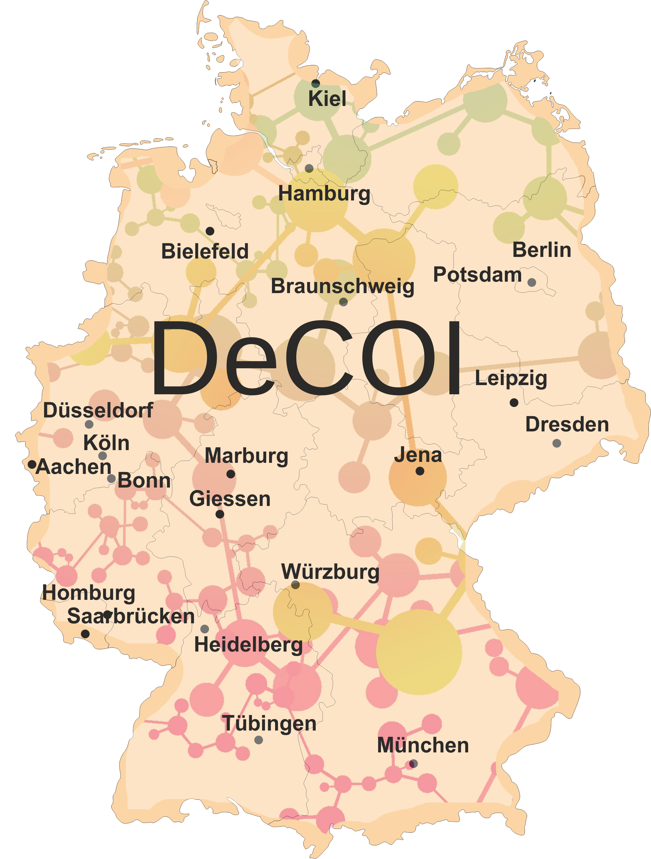










- Viral Genome Sequencing Group
Decentralized / federated
Since March 2020
Heterogeneous sequencing landscape
Various established protocols
Exchange of protocols, best practices, QC materials and tools
Open
Fast data sharing with community
Genomes and metadata submission: GISAID & RKI DESH
Funding sources:
DFG
NUM
Illumina
Central government & states
Lead: Alexander Dilthey (Düsseldorf)

Slide 3
SARS-CoV-2 genome sequencing in Germany: end of last year
GISAID: 753 viral genomes from Germany – 473 from DeCOI members (14 Nov 2020)
DeCOI current numbers:
 | Total | On GISAID
Bielefeld | 135 | 50
Dresden | 30 | 0
Düsseldorf | 477 | 322
Munich | 260 | 1
RKI | NA | 23
Saarbrücken | 65 | 25
Tübingen | 76 | 52
 | 1043 | 473
0.52% | 0.29% | 16.60% | 0.09% | 0.11% | 11.87% | 0.10% | 0.86% | 0.02% | 0.05% | 1.75% | 7.67% | 0.43%
Proportion cases sequenced (WHO/ GISAID)

Slide 4
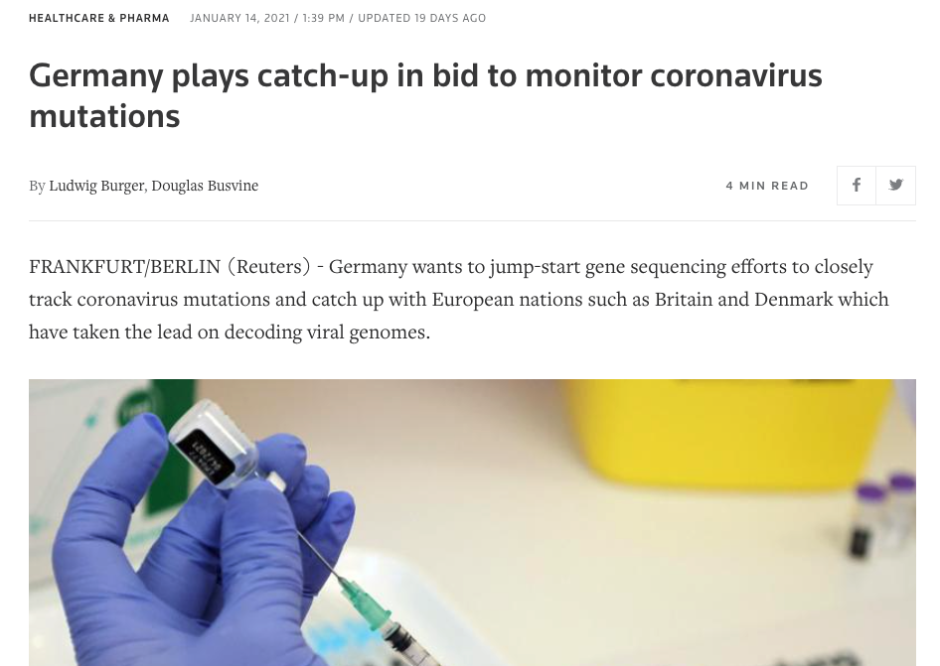
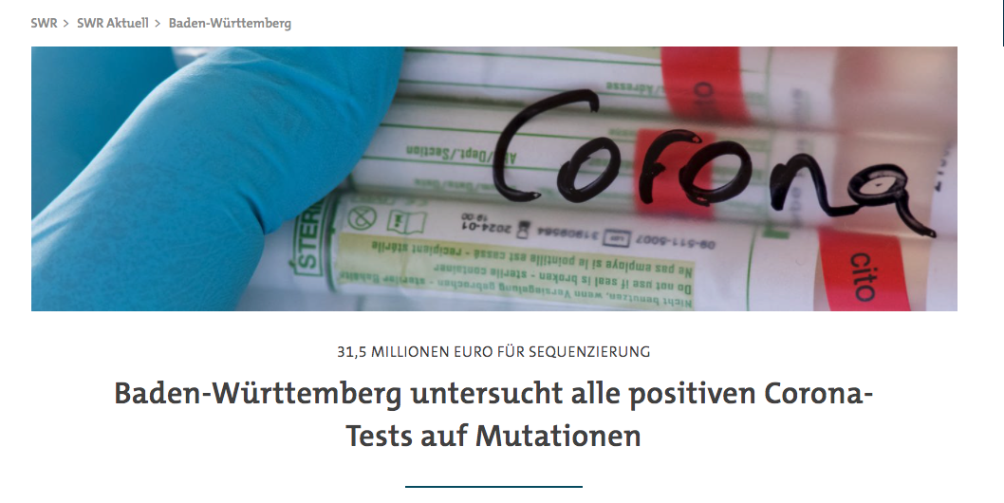
SARS-CoV-2 genome sequencing in Germany: January 2021
Sequencing of viral genomes for 5-10% of positive cases:
State of Baden-Württemberg:
Sequencing of all positive cases

Slide 5
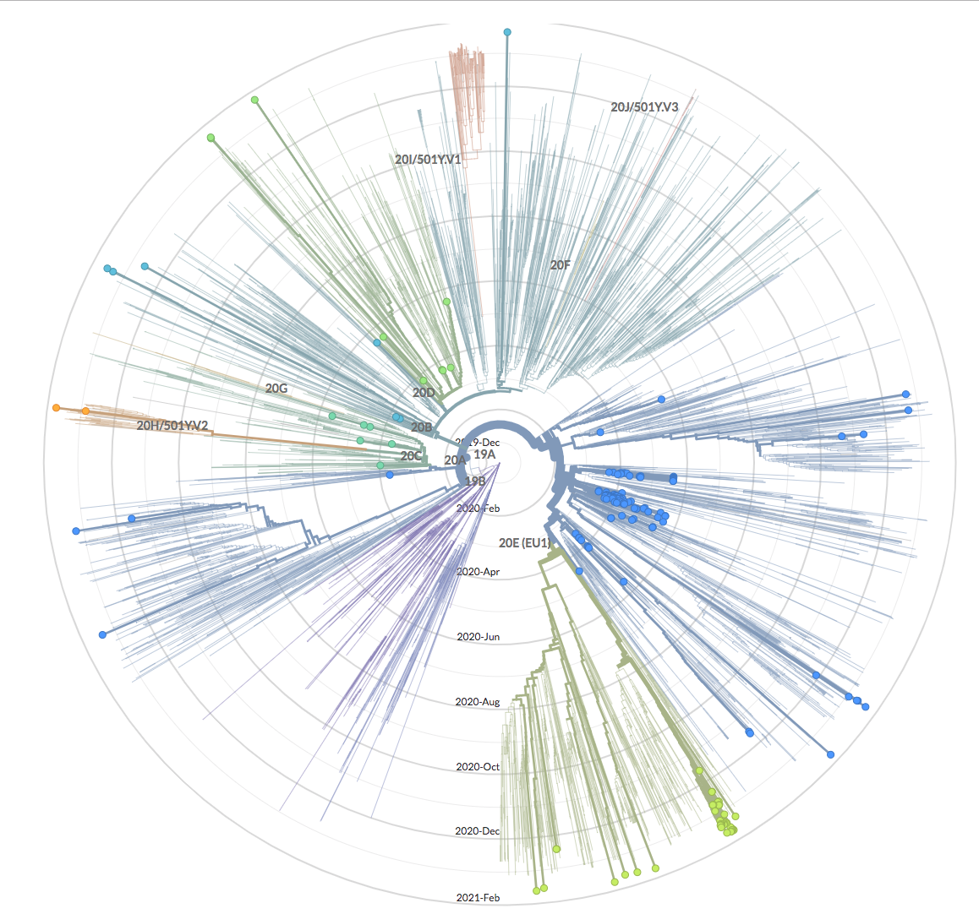
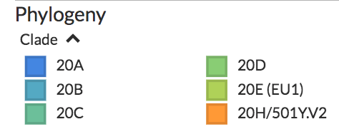
NextStrain: European Clades

Slide 6
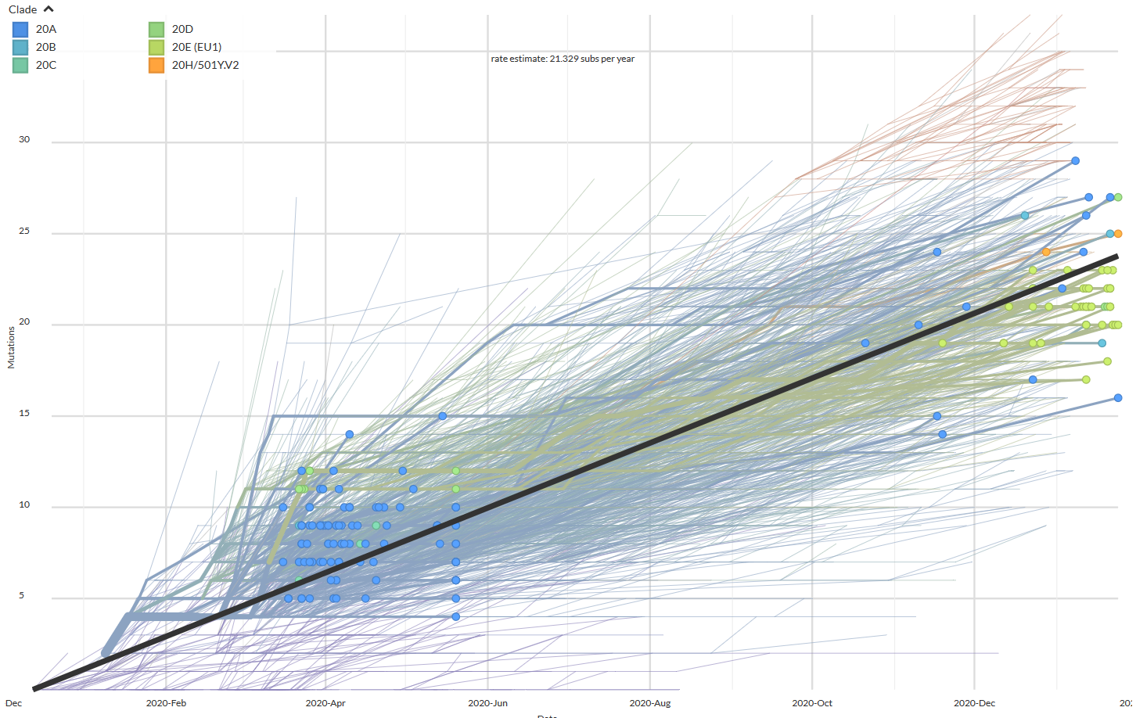
NextStrain: Linearly Increasing Divergence of Strains

Slide 7
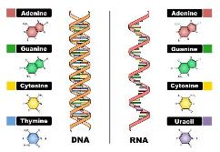
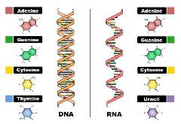
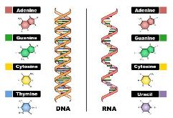
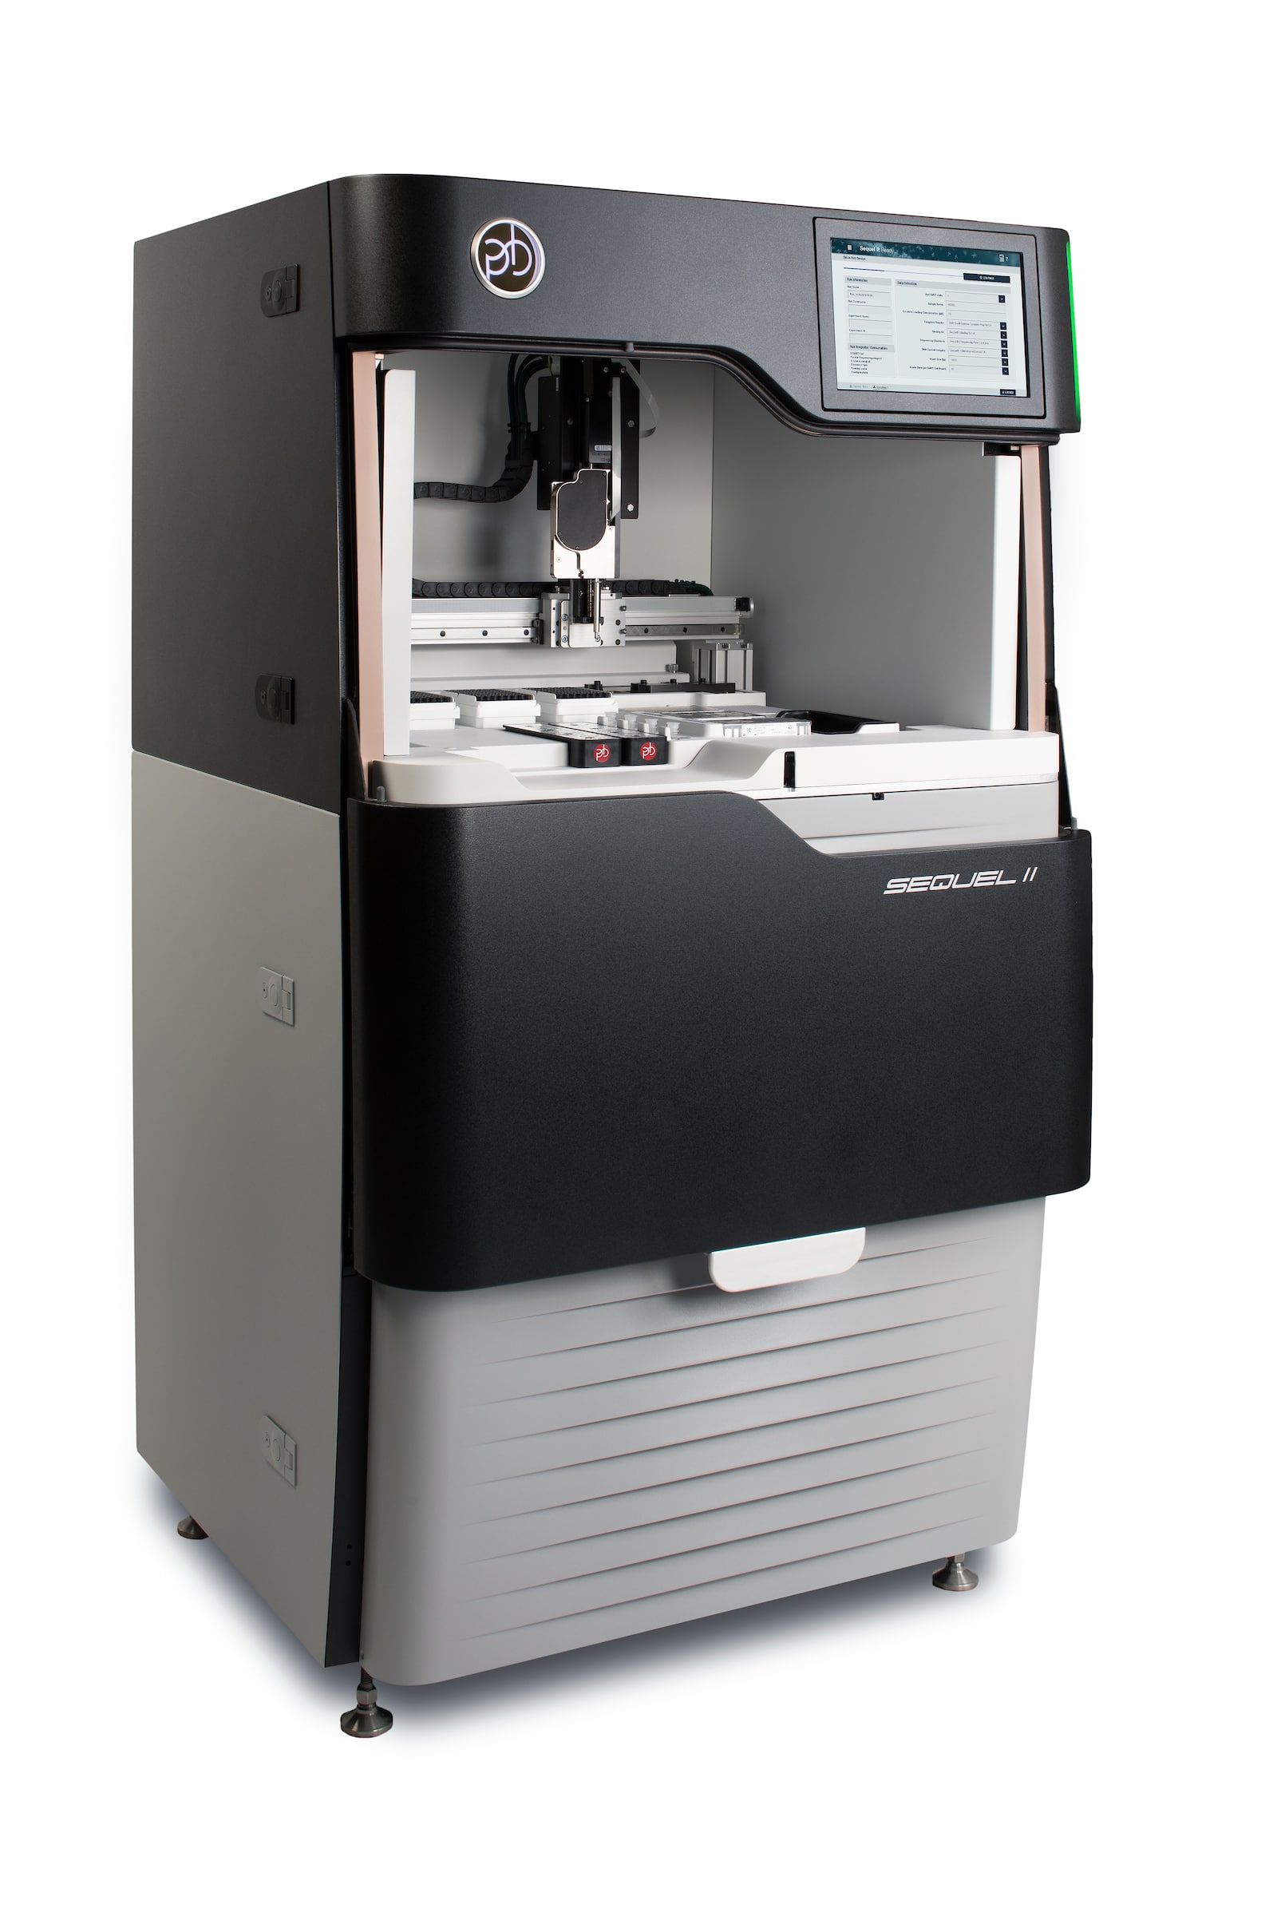
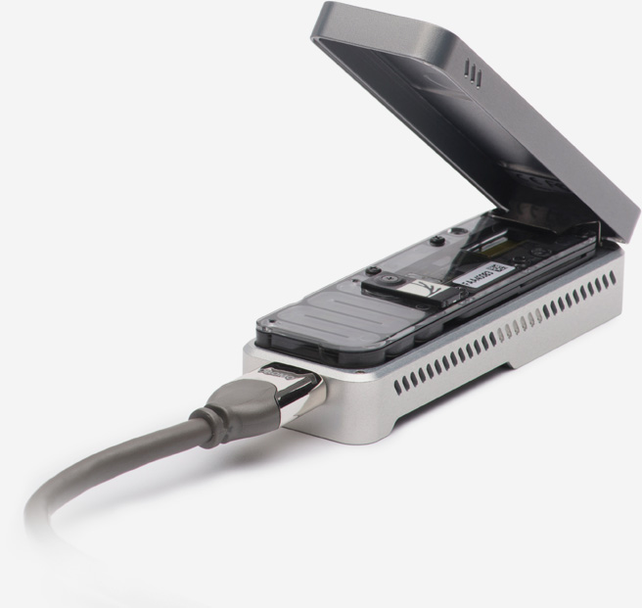
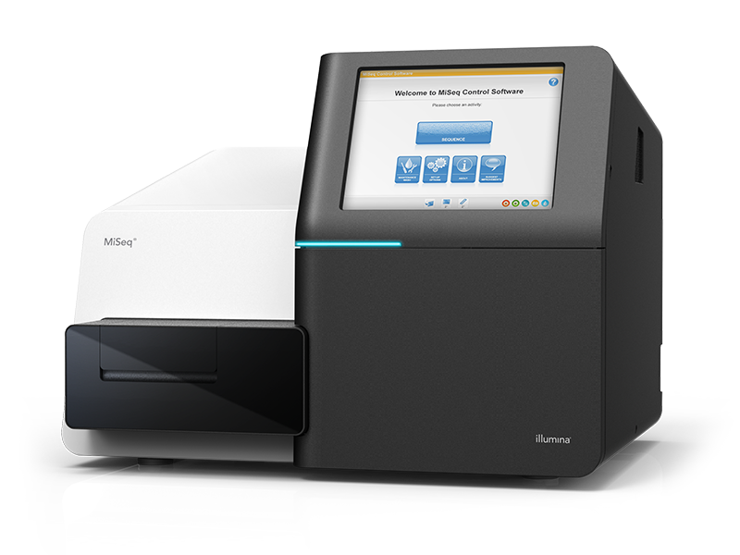
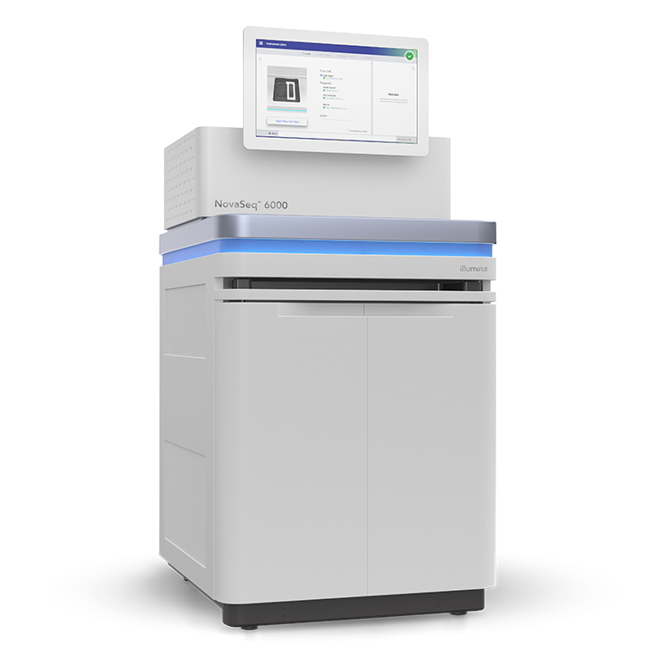
Sequencing Strategies for SARS-CoV2 Genomes
SARS-CoV-2 RNA: 29,882 nt
Reverse transcription of the complete SARS-CoV-2 RNA
PCR amplification
Short and long amplicon panels
Hybridization based enrichment
Twist SARS-CoV2 panel
Short amplicon = ARTIC panel
Read out: MinION or MiSeq
Short amplicon = EDEN panel
Read out: SEQUEL or MiSeq
Twist enrichment panel
Read out: MiSeq or NovaSeq

Slide 8


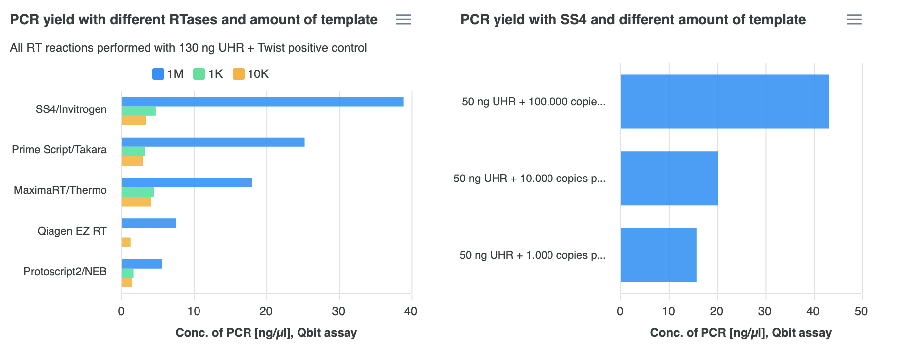
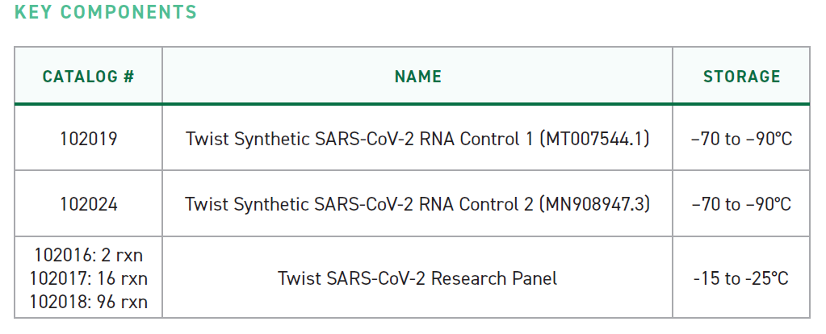
PCR Yield with Reverse Transcriptases
*
1M
10K
1K
*
Angel Angelov, Michael Sonnabend, Silke Peter

Slide 9
Michaela Pogoda (UKT), Tina Han, Ulrike Harms, Oliver Stephan (Twist Bioscience)
Twist SARS-CoV2 Panel
Prepped Library Fragments
Blocked Library Fragments
Hybridized Library Fragments
Bead-Bound Target Sequences
Universal Blockers and COT-1
TWIST DNA Probes
Streptavidin Beads
Sense Strand
Anti-Sense Strand
Dual Adapters
Biotin
https://www.twistbioscience.com/resources/product-sheet/twist-sars-cov-2-research-panel
Tina Han, Ulrike Harms, Oliver Stephan (Twist Bioscience)

Slide 10
CT value vs. Viral Copies vs. Seq-Depth
Patient Samples
Synthetic Samples
Coverage
CT 15
CT 22.5
CT 24.2
CT 26.1
CT 26.3
CT 27.8
CT 28.4
CT 28.8
1.000.000 copies
100.000 copies
10.000 copies
1.000 copies
Experiments: Michaela Pogoda
Clinical samples collected & processed by:
Michael Bitzer, Siri Göpel, Tina Ganzenmüller,
Michael Sonnabend, Angel Angelov, Silke Peter, Daniela Bezdan, Angelika Iftner, Thomas Iftner

Slide 11
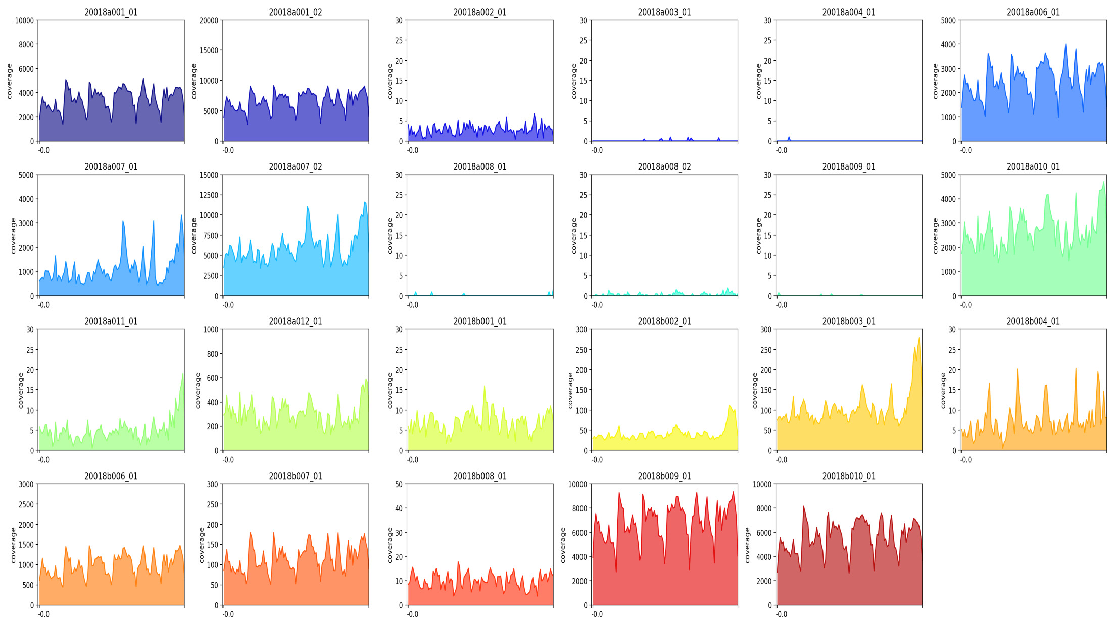

Coverage Profiles & Sequencing Yield
* Dilution: Synthetic SARS-CoV2 copies per ul
1 Mio *
100.000 *
10.000 *
Coverage
1.000 *
100 *
10 *
Genomic position

Slide 12

Coverage Profiles for Clinical Samples
CT 15,0
CT 22,5
CT 24,2
Coverage
CT 26,02
CT 27,8
CT 28,4
Genomic position
CT >30
We do not get continuous coverage for samples with Ct > 28
We get hardly any reads with Ct > 30

Slide 13
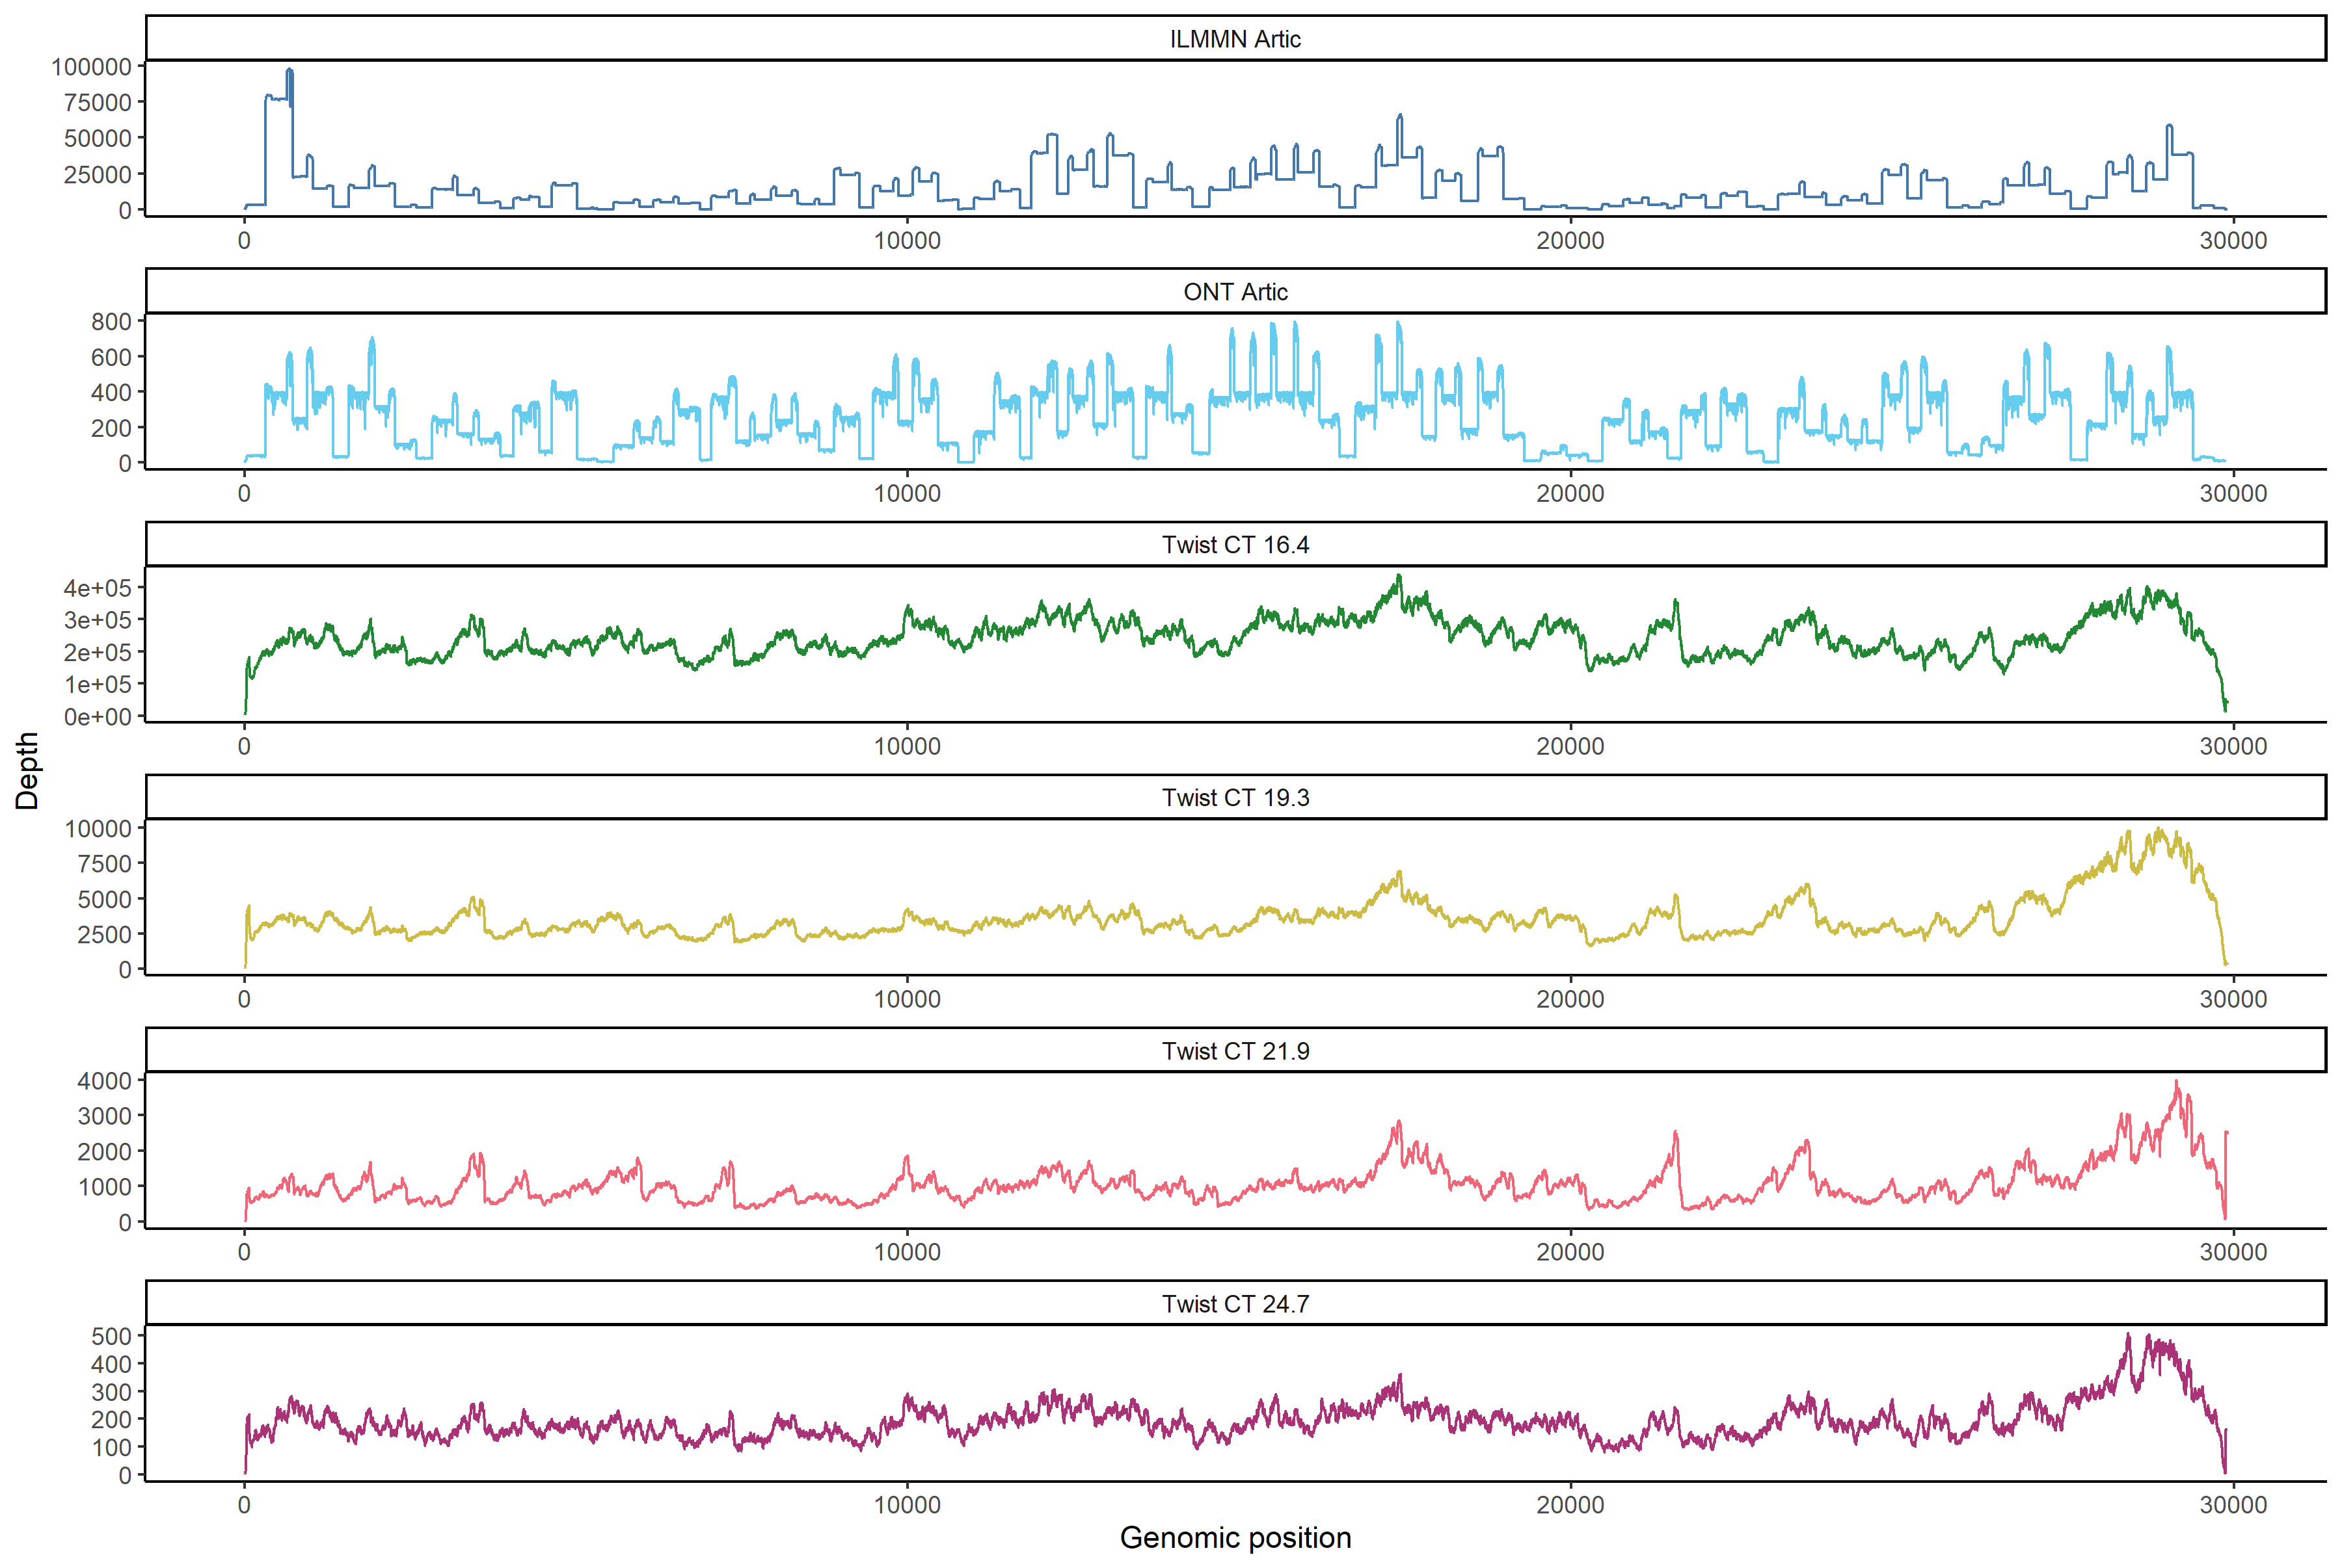
Coverage ARTIC vs. Twist
ILMN Artic
ONT Artic
Twist CT 16.4
Twist CT 19.3
Twist CT 21.9
Twist CT 24.7

Slide 14

Generating Consensus Genome
Remove Human Reads: KRAKEN2
Alignment to Reference: bwa mem
Variant Calling: iVar
Post-processing
Clade Assignment: Pangolin
Consensus Generation: iVar
Phylogeny: NextStrain
Viral Genome
Amino-Acid Anno: NextClade
GISAID
umiVar: https://github.com/imgag/umiVar
Caspar Gross, Ersoy Kocak, Leon Schütz, Jakob Admard

Slide 15
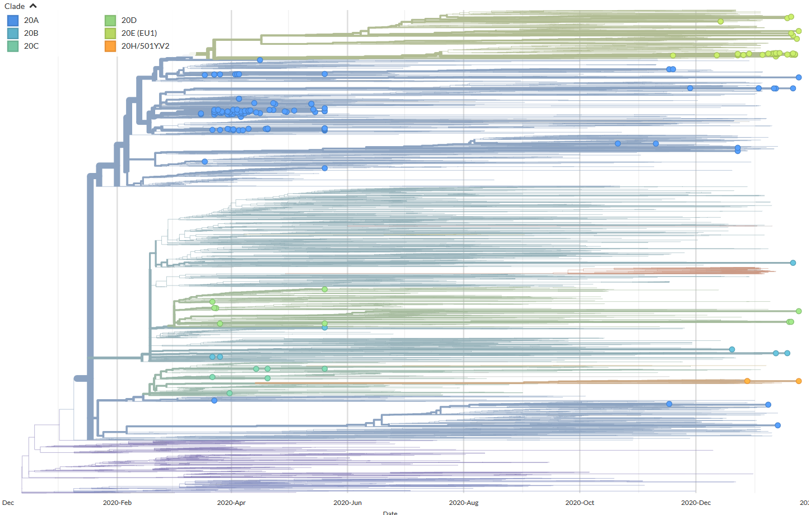
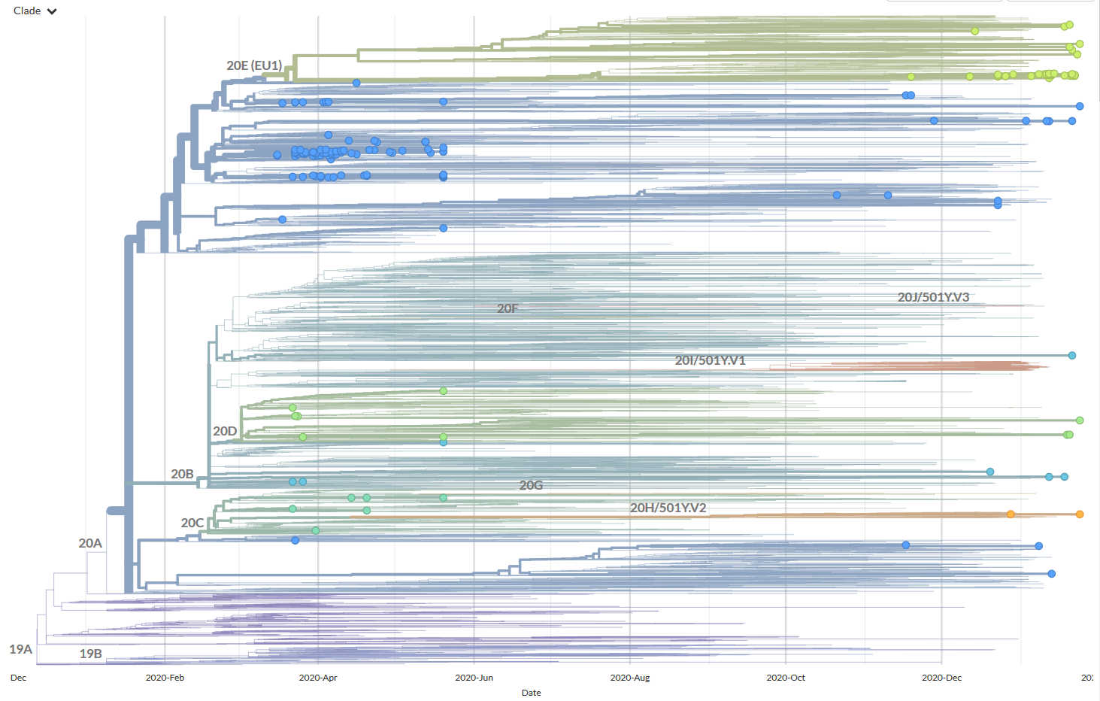
Clades of Samples from Tübingen
xxx

Slide 16
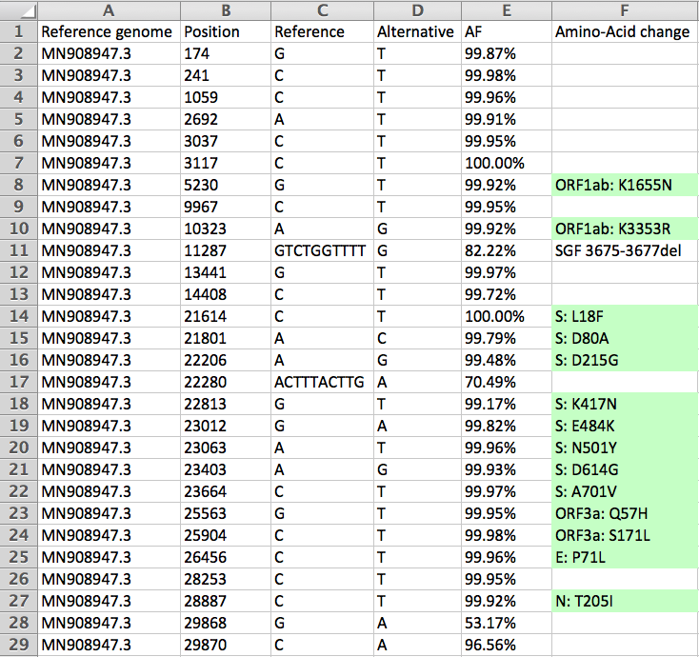
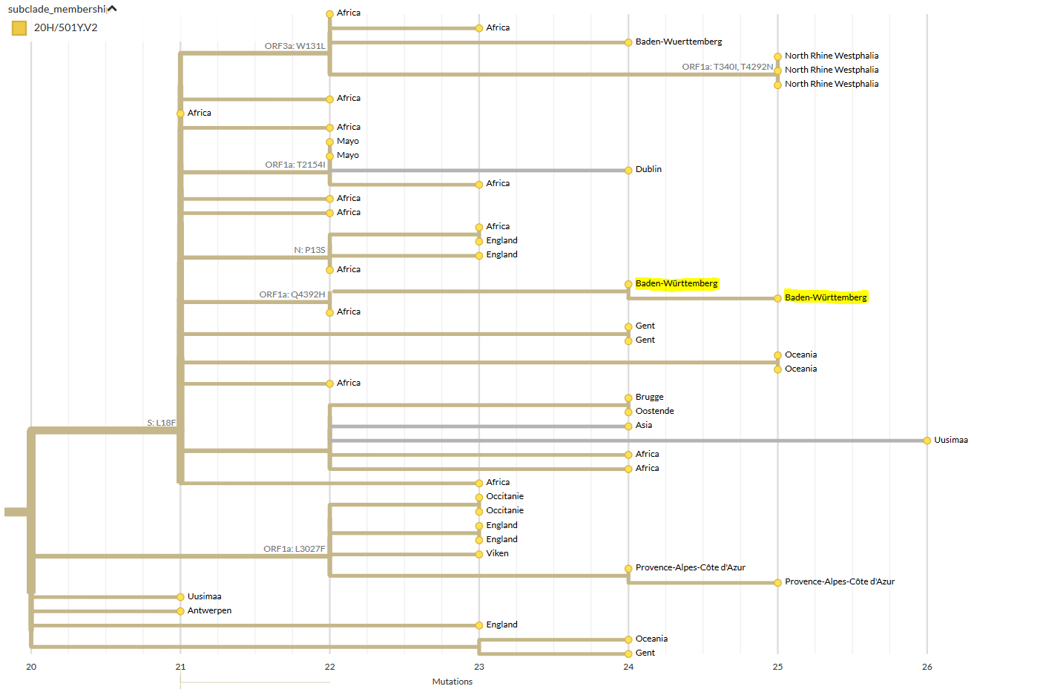
South African B1.351 in Tübingen
Tina Ganzenmüller, Virology, UKT

Slide 17
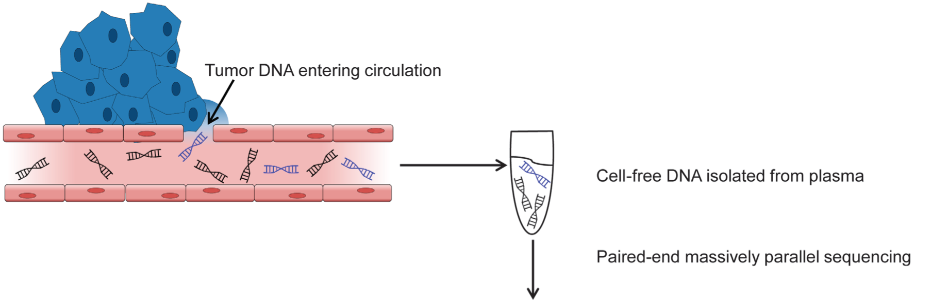
Brainstorming: Liquid Biopsy
Circulating cell-free DNA
Tiny fraction of circulating tumor DNA detected as biomarker of cancer
Identify true somatic mutation

Slide 18
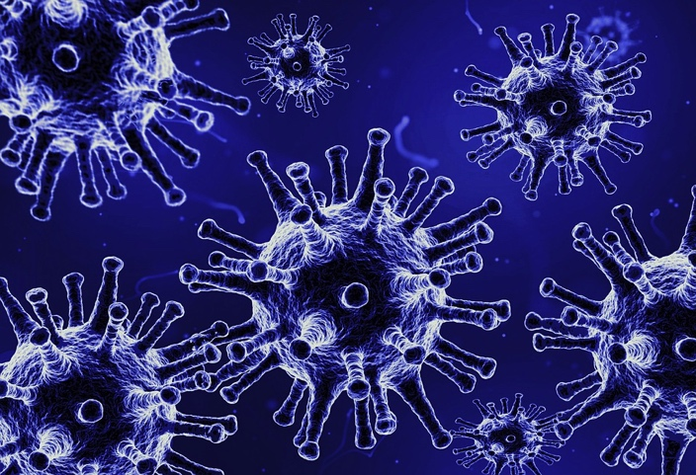
Ultradeep-Sequencing
Virus population in the host
cDNA
RNA extraction &
Reverse Transcription
Tiny fraction of the SARS-CoV-2 viruses in a sample carry a novel mutation
Ultra-Deep Sequencing: 1,000,000x Coverage

Slide 19
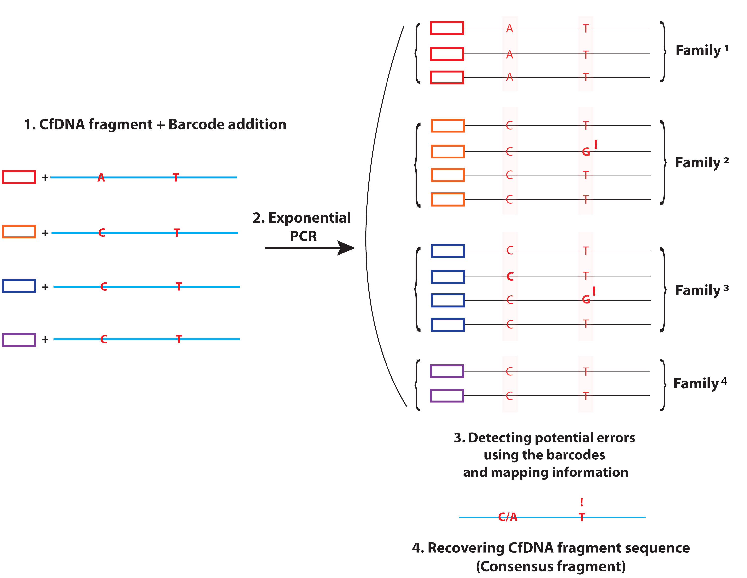
Ultradeep-Sequencing with UMIs
Virus population in the host
cDNA
RNA extraction &
Reverse Transcription
Unique Molecular
Barcodes (UMI)

Slide 20
More Duplicates = Better Correction
Error correction level:
Depth of coverage per correction level:
3x
Error correction level
4x
4x
2x
1x
2x
3x
>4x
Error correction level

Slide 21
Error Rates per Nucleotide
1 error / 1400
sequenced nucleotides
1 error / 40,000
sequenced nucleotides
1x
2x
3x
>4x
Error correction level

Slide 22
Seq-Errors per Genomic Position
Uncorrected reads
.
.
.
C
Fraction of Positions in %
C
C
T
Ref
n Errors per genomic position

Slide 23
Seq-Errors per Genomic Position
2-Copy
Correction
.
.
.
C
Fraction of Positions in %
C
C
T
Ref
n Errors per genomic position

Slide 24
Seq-Errors per Genomic Position
Errors per 1000x coverage
.
.
.
C
C
C
T
n Errors per genomic position
Statistical model in umiVar: https://github.com/imgag/umiVar

Slide 25
Variant Detection Pipeline umiVar
De-Duplication
Error-Correction
Alignment
Low-Frequency Variant Detection (SNV, InDels)
umiVar
VarScan
LoFreq
iVar
Statistical Analysis
umiVar: https://github.com/imgag/umiVar
Caspar Gross, Ersoy Kocak, Leon Schütz, Jakob Admard

Slide 26
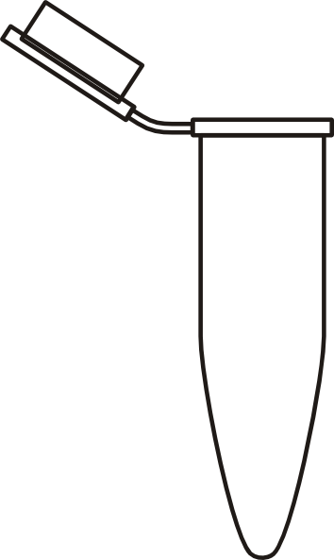
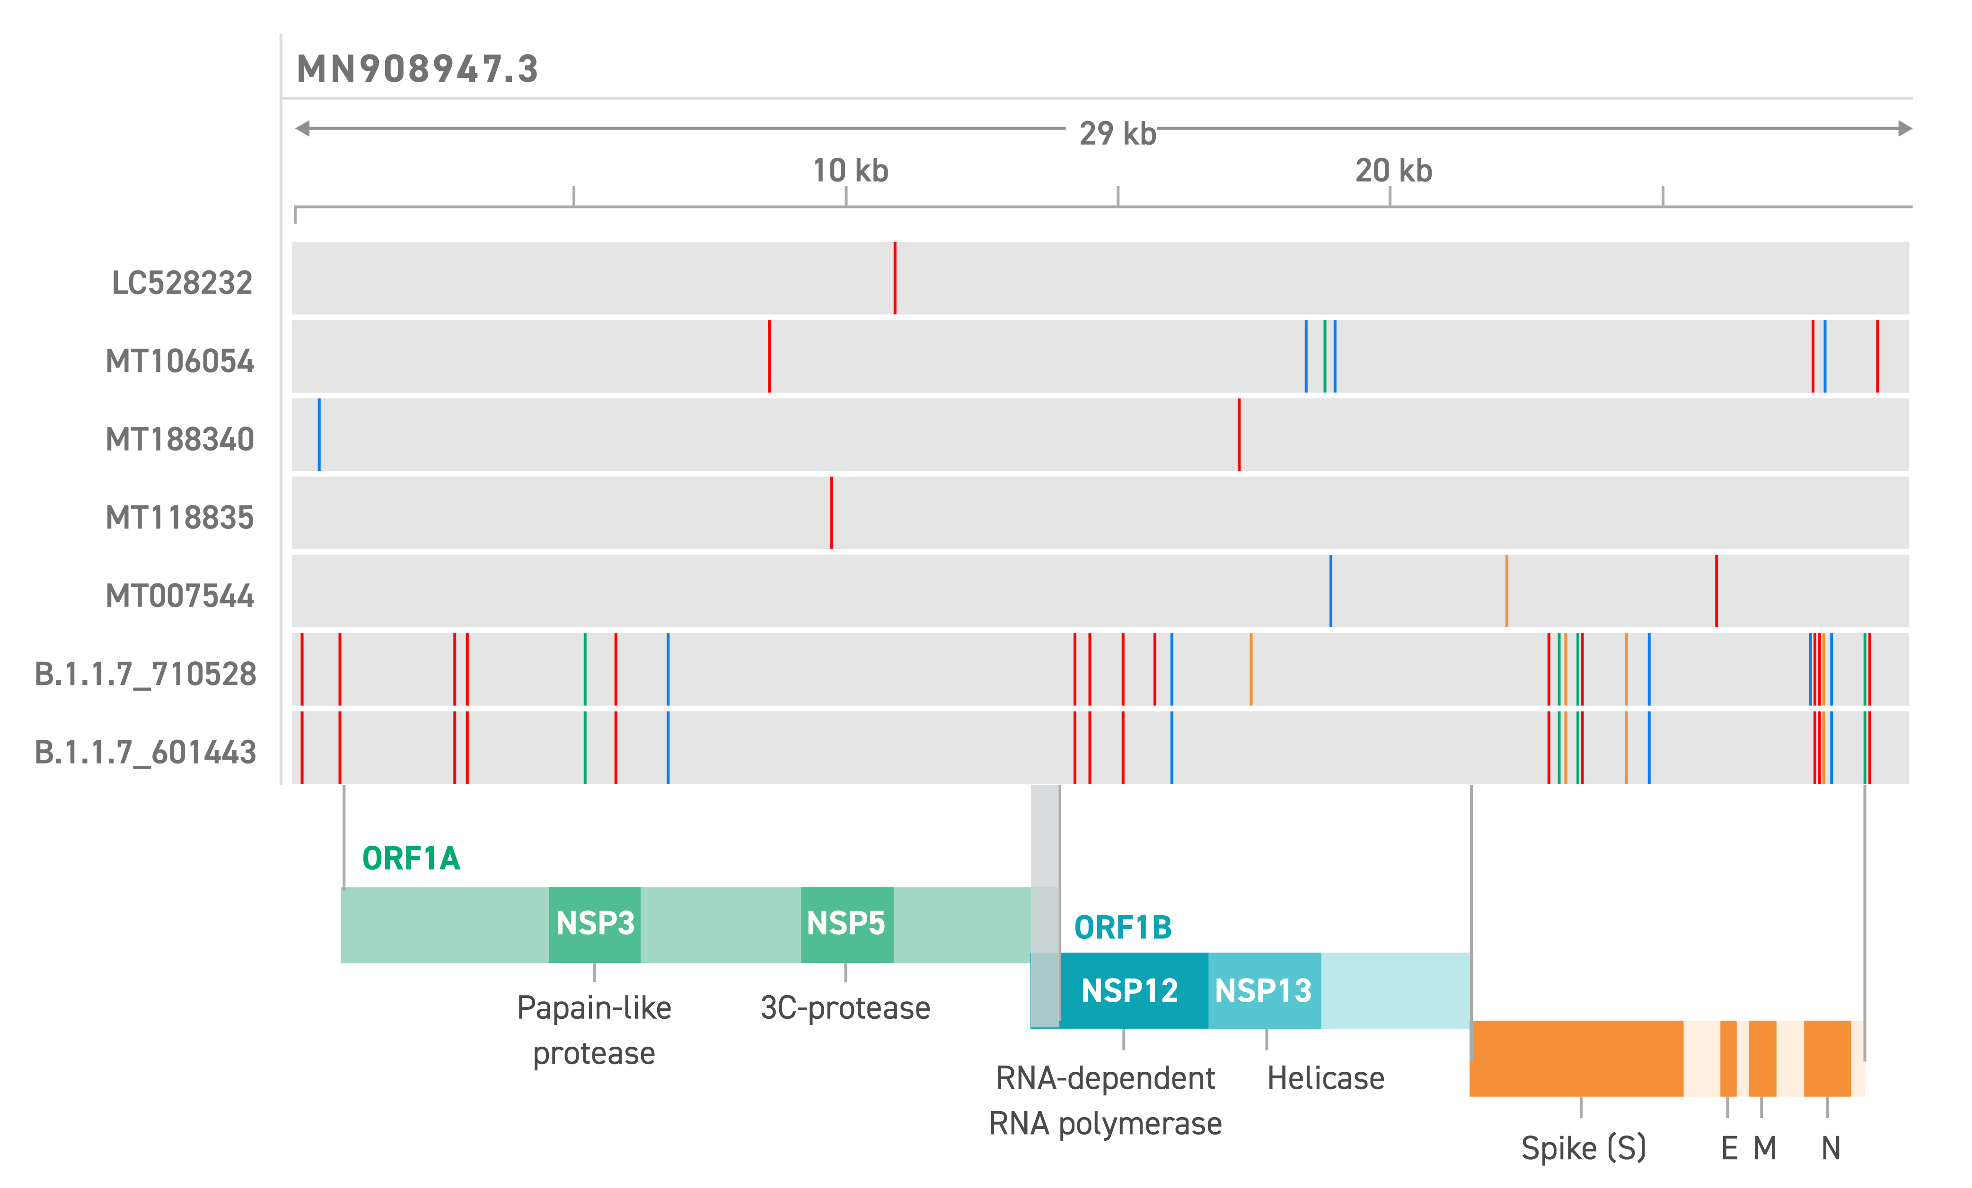
Generating Synthetic Mixed Populations
1%
99%
Seq

Slide 27
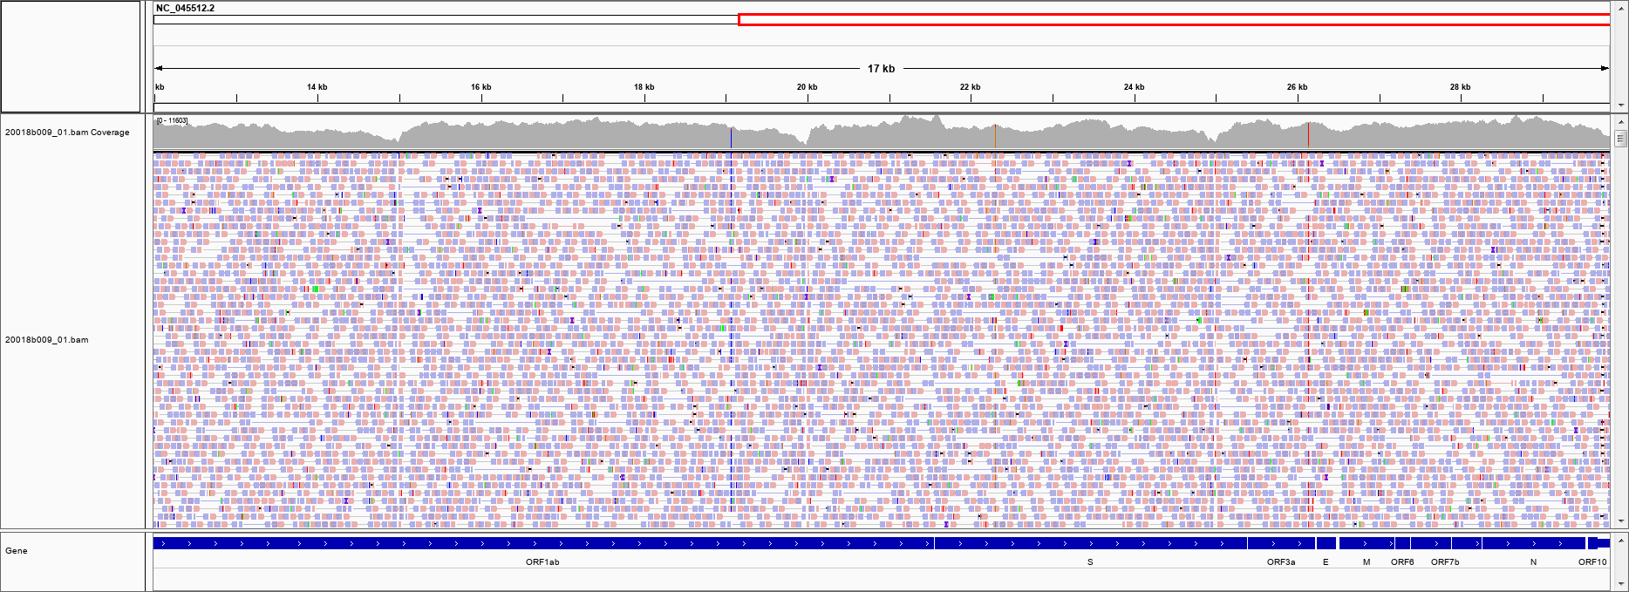
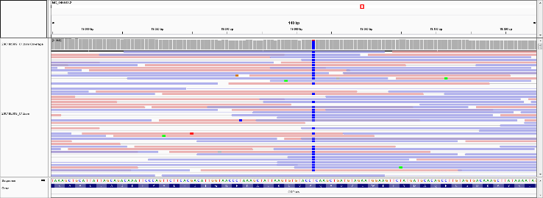
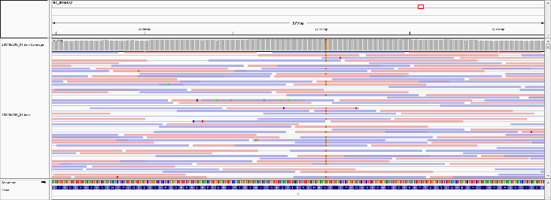
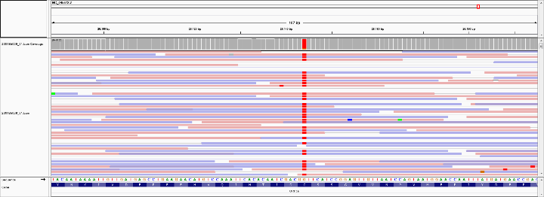
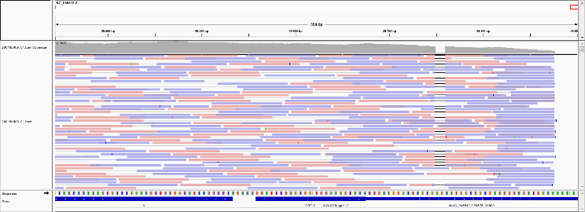
SNV-calling in Synthetic 99:1 Mix
Position | 19065 | 22303 | 26144 | 29754
Reads | 6087 | 6566 | 7025 | 38
A | 11 | 3 | 2 | 0
C | 5994 (99%) | 1 | 1 | 38 (1%)
G | 2 | 6462 (98.5%) | 120 (2%) | 0
T | 77 (1%) | 98 (1.5%) | 6901 (98%) | 0
Dels |  |  |  | 3769 (99%)

Slide 28
SNV-calling in up to Synthetic 1:999 Mix
Position | Change | %1 Mix (reads / AF) | %0.5 Mix (reads / AF) | %0.1 Mix (reads / AF)
19065 | T -> C | 348/38498 (0.9%) | 204/41687 (0.49%) | 78/40984 (0.19%)
22303 | T -> G | 385/45576 (0.85%) | 229/50939 (0.45%) | 64/49169 (0.13%)
26144 | G -> T | 507/47843 (1.05%) | 349/51955 (0.67%) | 113/49886 (0.23%)
29754 | C -> DEL | 180/20379 (0.89%) | 66/22176 (0.30%) | 19/21622 (0.09%)
SNVs and indels can be detected even at 0.1% fraction
About 50% drop in coverage around the indel, but still detectable
Test with synthetic SARS-CoV-2 strains with more SNVs and indels would be helpful to better estimate sensitivity

Slide 29
Outlook: Benchmark with synthetic British strain B.1.1.7
Twist Synthetic Viral Controls:
https://www.twistbioscience.com/products/ngs/synthetic-viral-controls?tab=sars-cov-2-controls

Slide 30
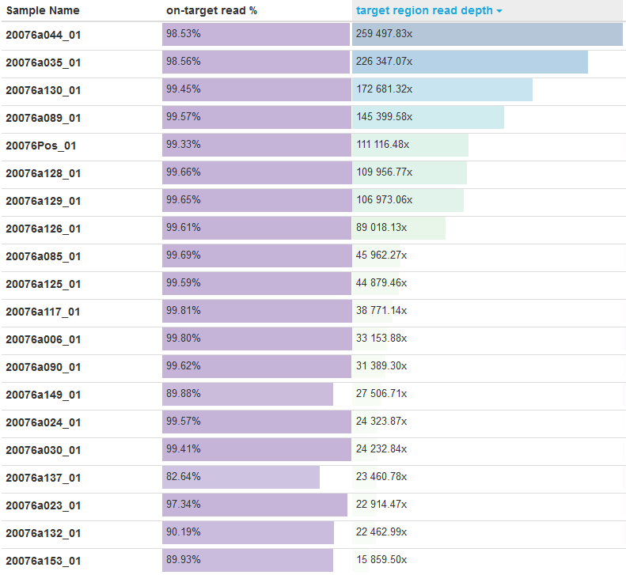
Ultra-deep Sequencing of Clinical Samples
… total of 80 clinical samples sequenced ultra-deep with UMI
Michaela Pogoda

Slide 31
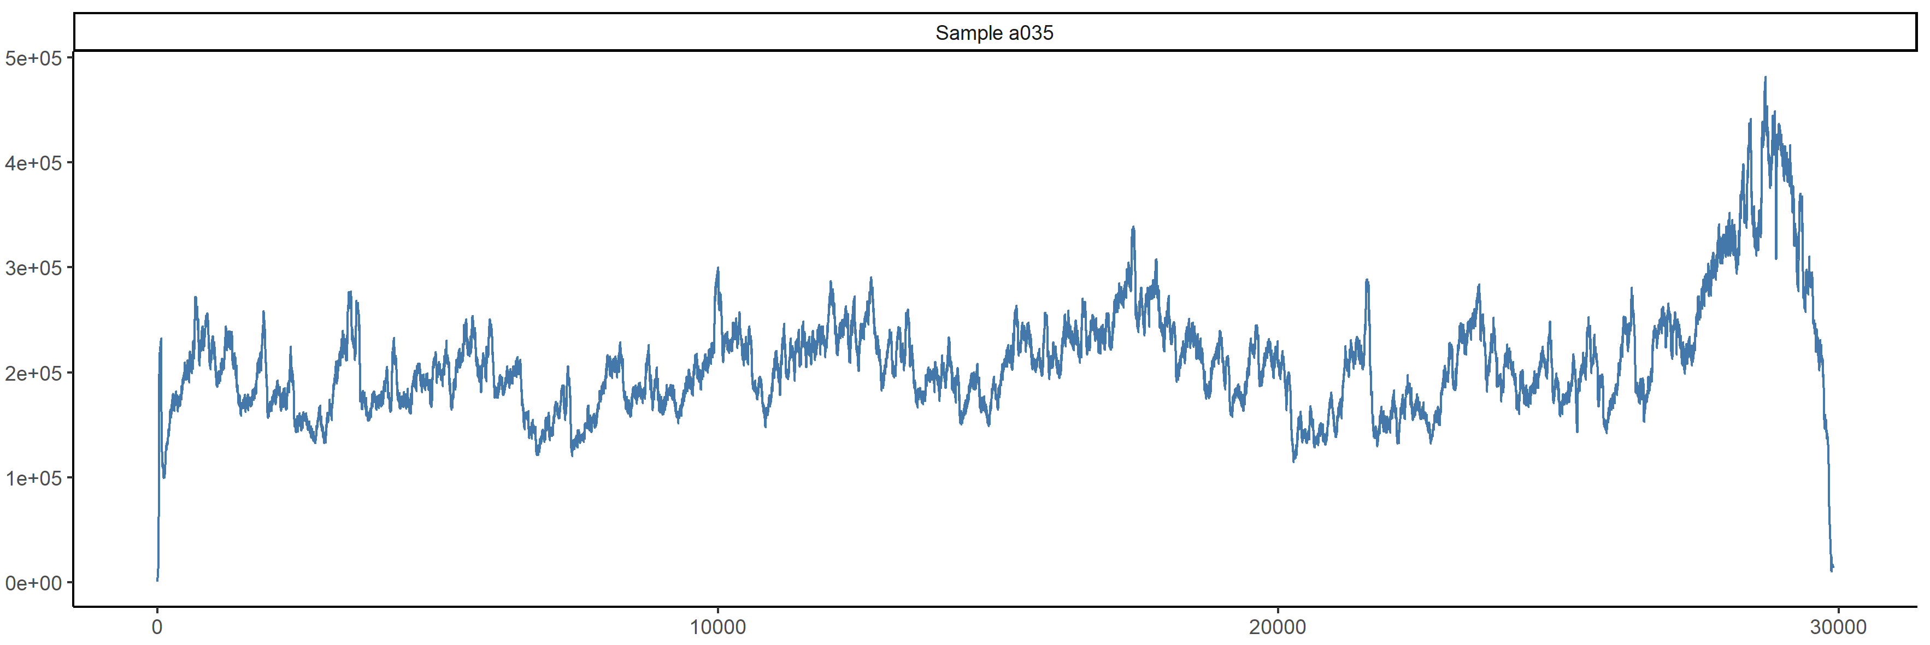
De-Duplicated Coverage Distribution
De-duplication = merging of PCR duplicates using UMIs
Leads to ‘true coverage’ representing unique RNA molecules
Errors are corrected during de-duplication
Sample 35: 226,000x => 25,000x coverage

Slide 32
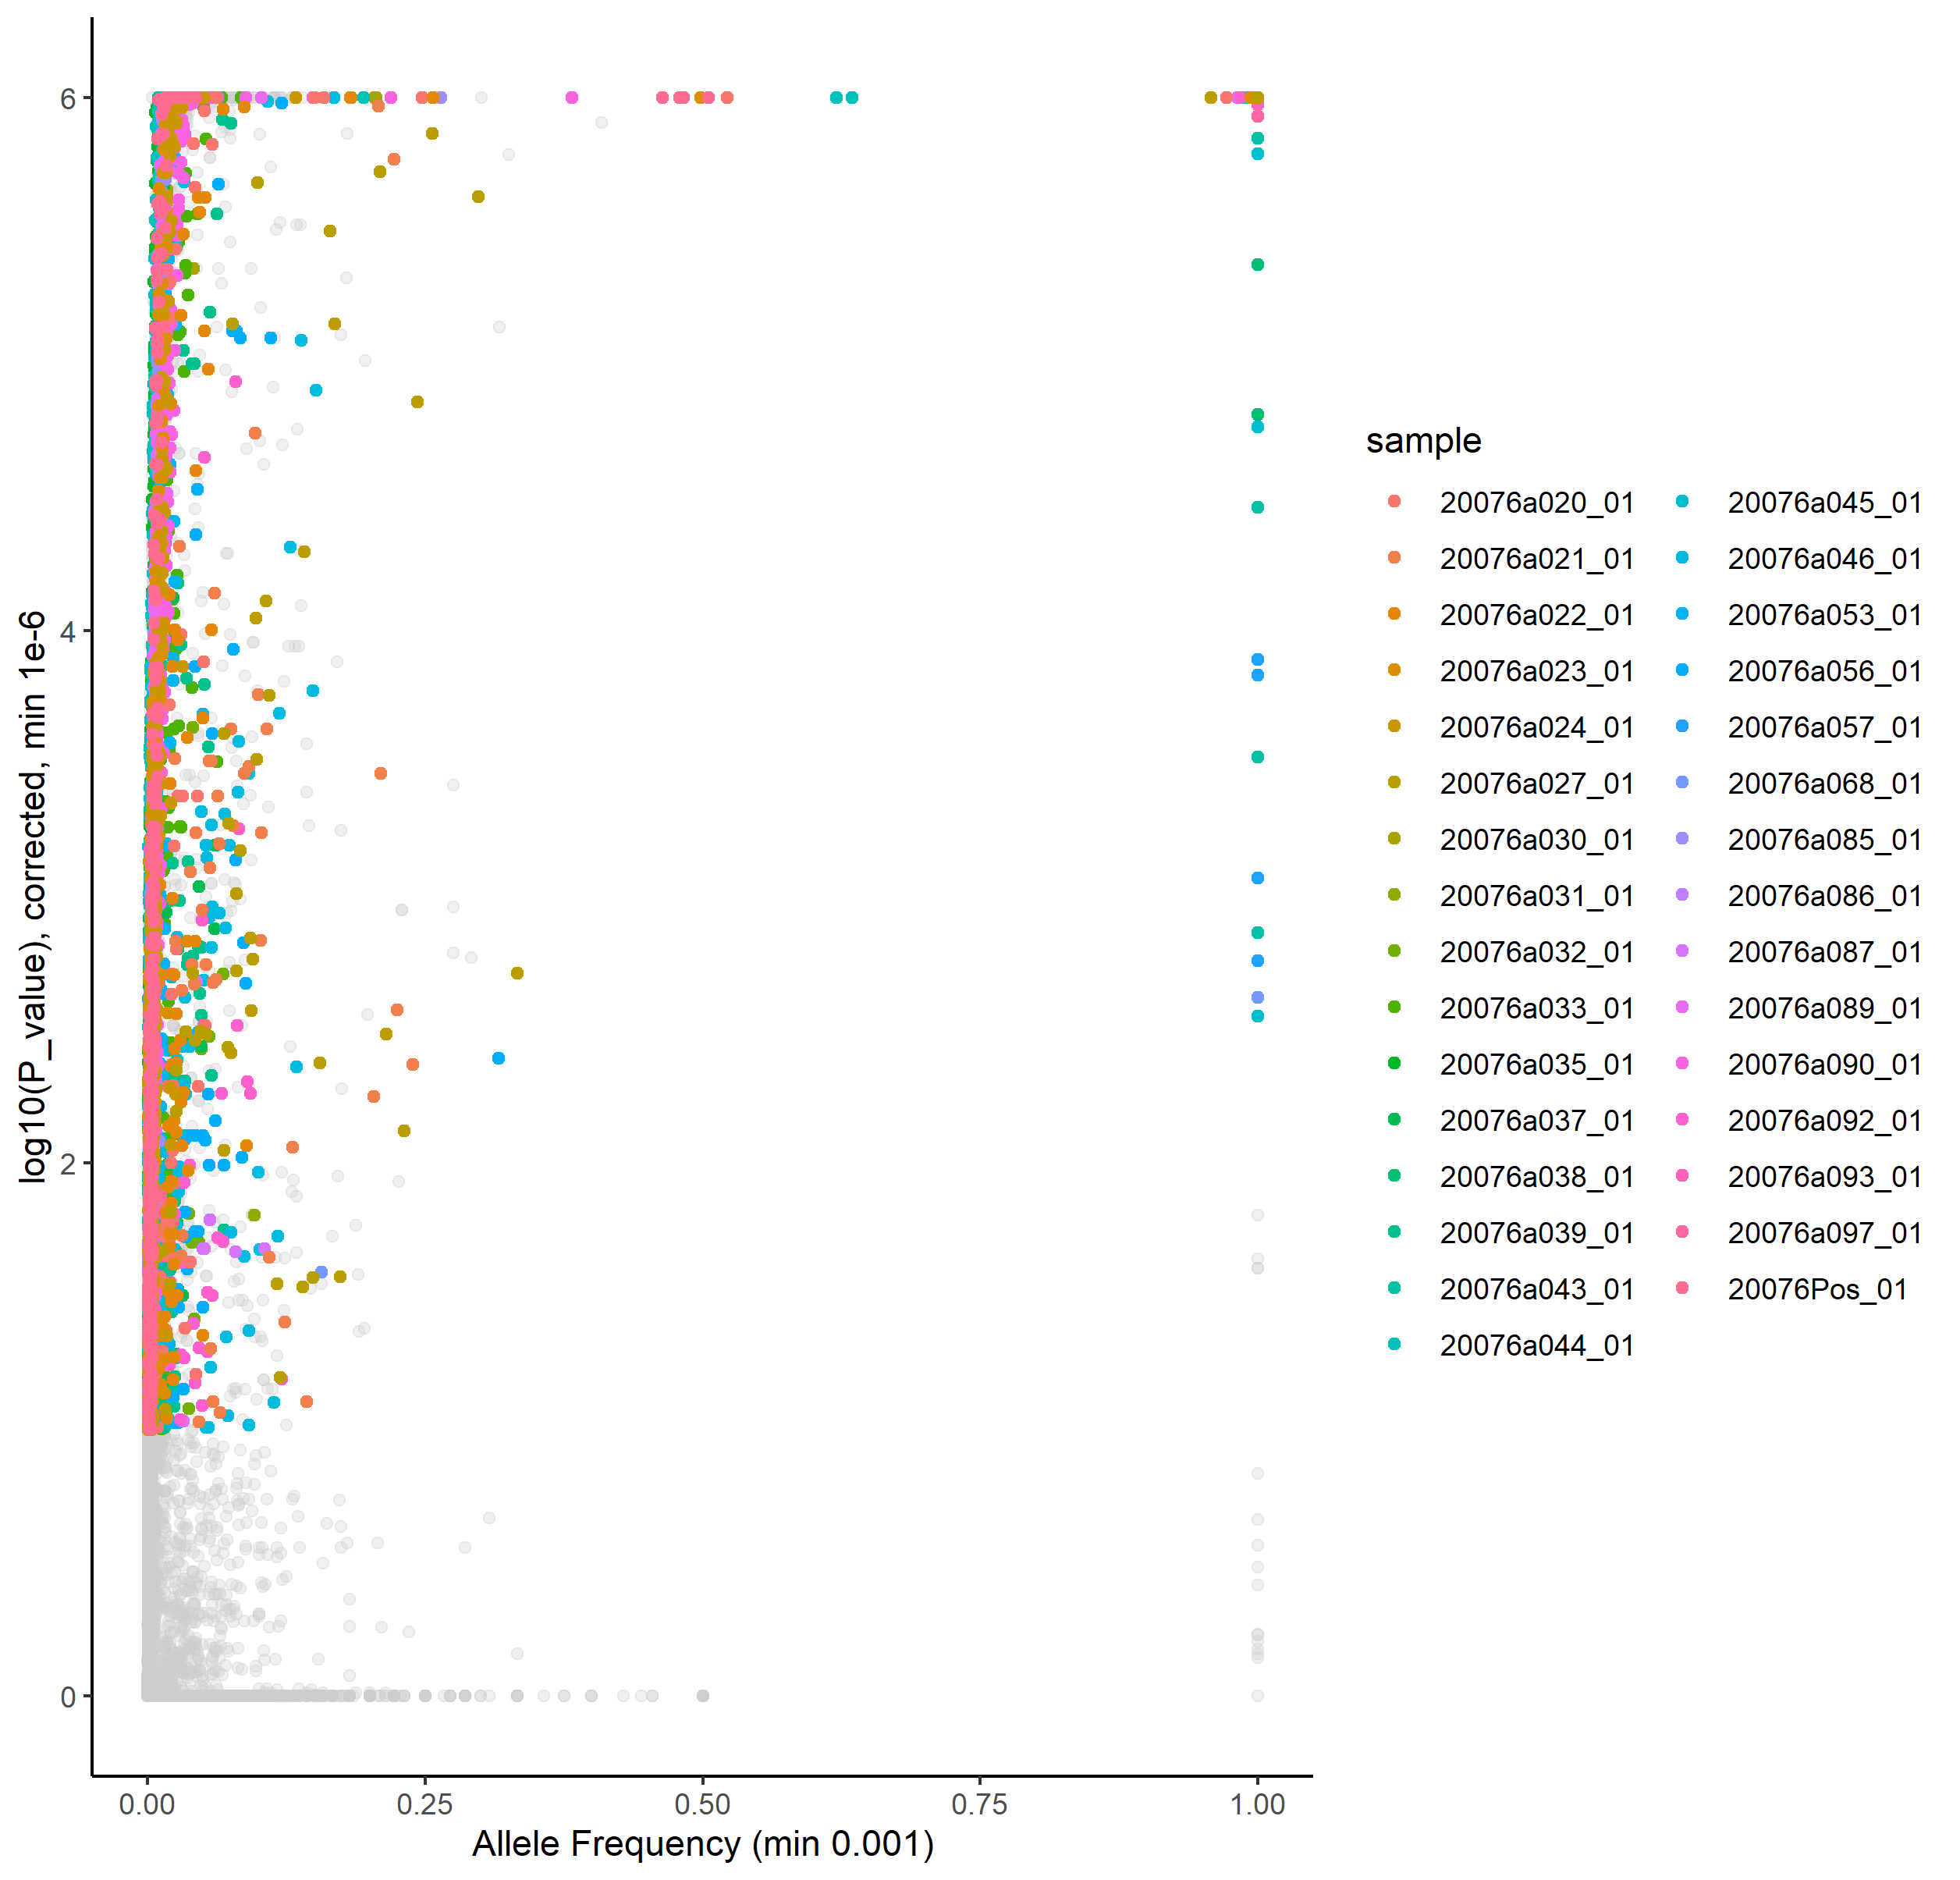
Variants Detected by umiVar
Caspar Gross, Ersoy Kocak

Slide 33
Variants Detected by umiVar
Clonal SNVs

Slide 34
Variants Detected by umiVar
Mixed Populations?

Slide 35
Variants Detected by umiVar
AF 2% - 25%

Slide 36
Variants Detected by umiVar
Very low-frequency variants: <2%

Slide 37
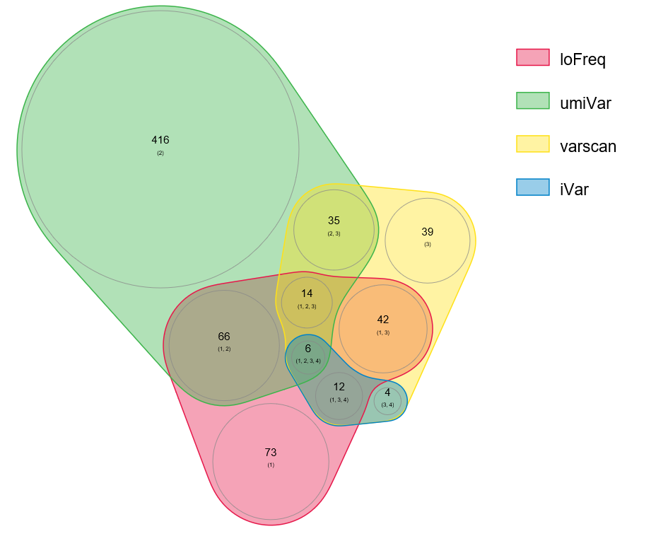
Comparison of 4 Variant Callers
Sample 35
Allele Fraction < 1%
Caspar Gross, Ersoy Kocak

Slide 38
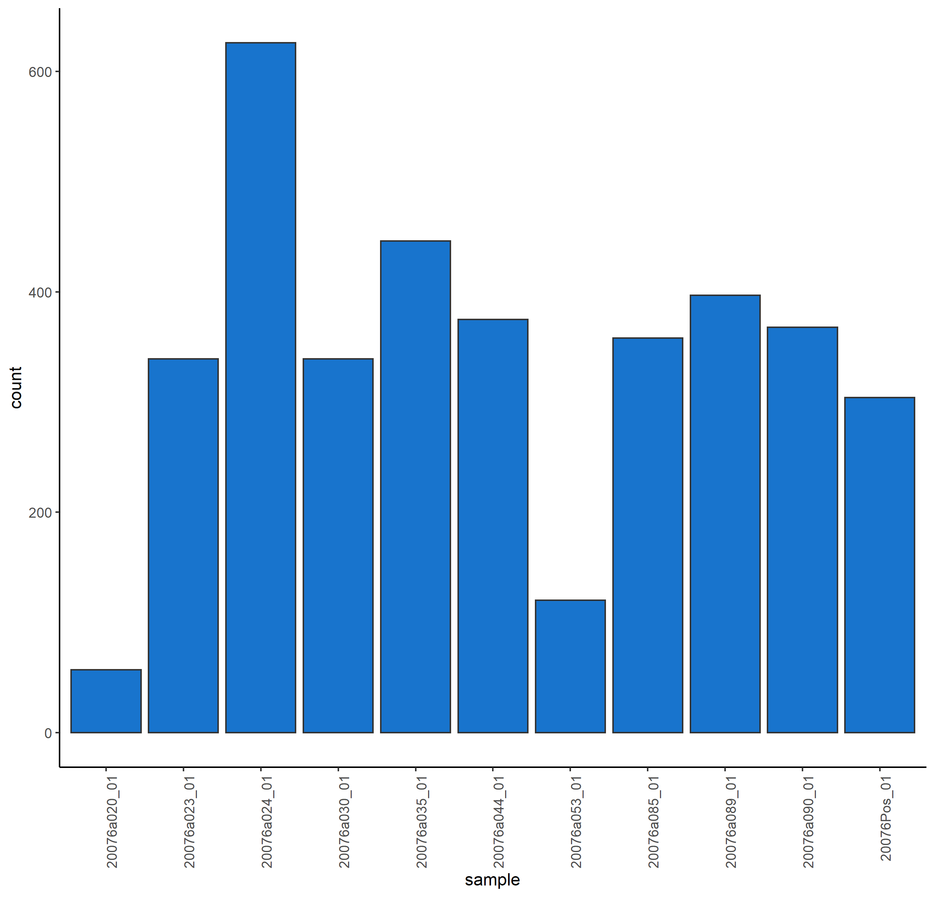
SNVs per Sample with >1000x Coverage

Slide 39
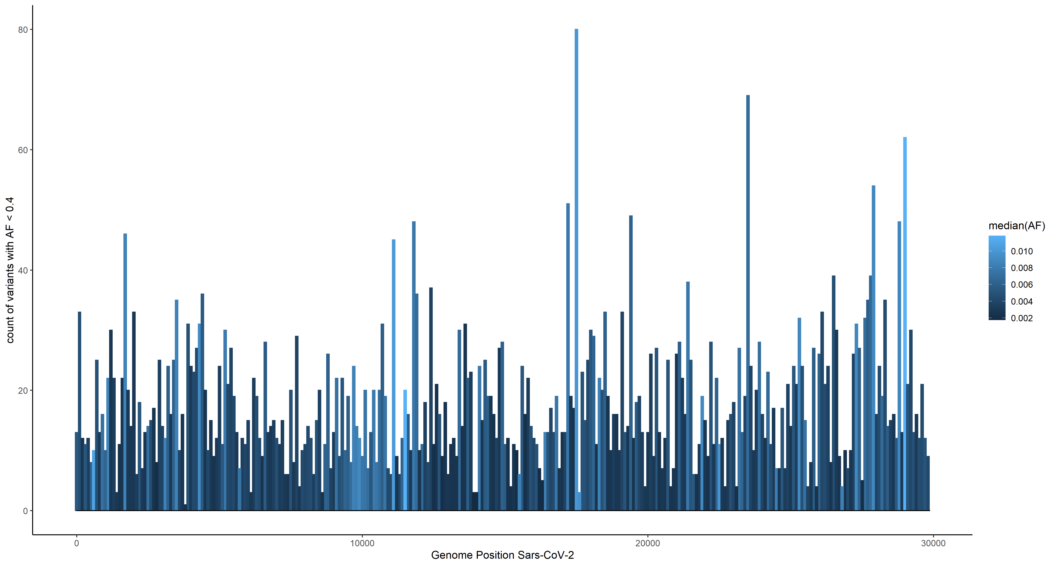
Distribution of low-AF variants across 32 Samples
Number of detected variants per bin
Genomic Position in 100bp bins

Slide 40
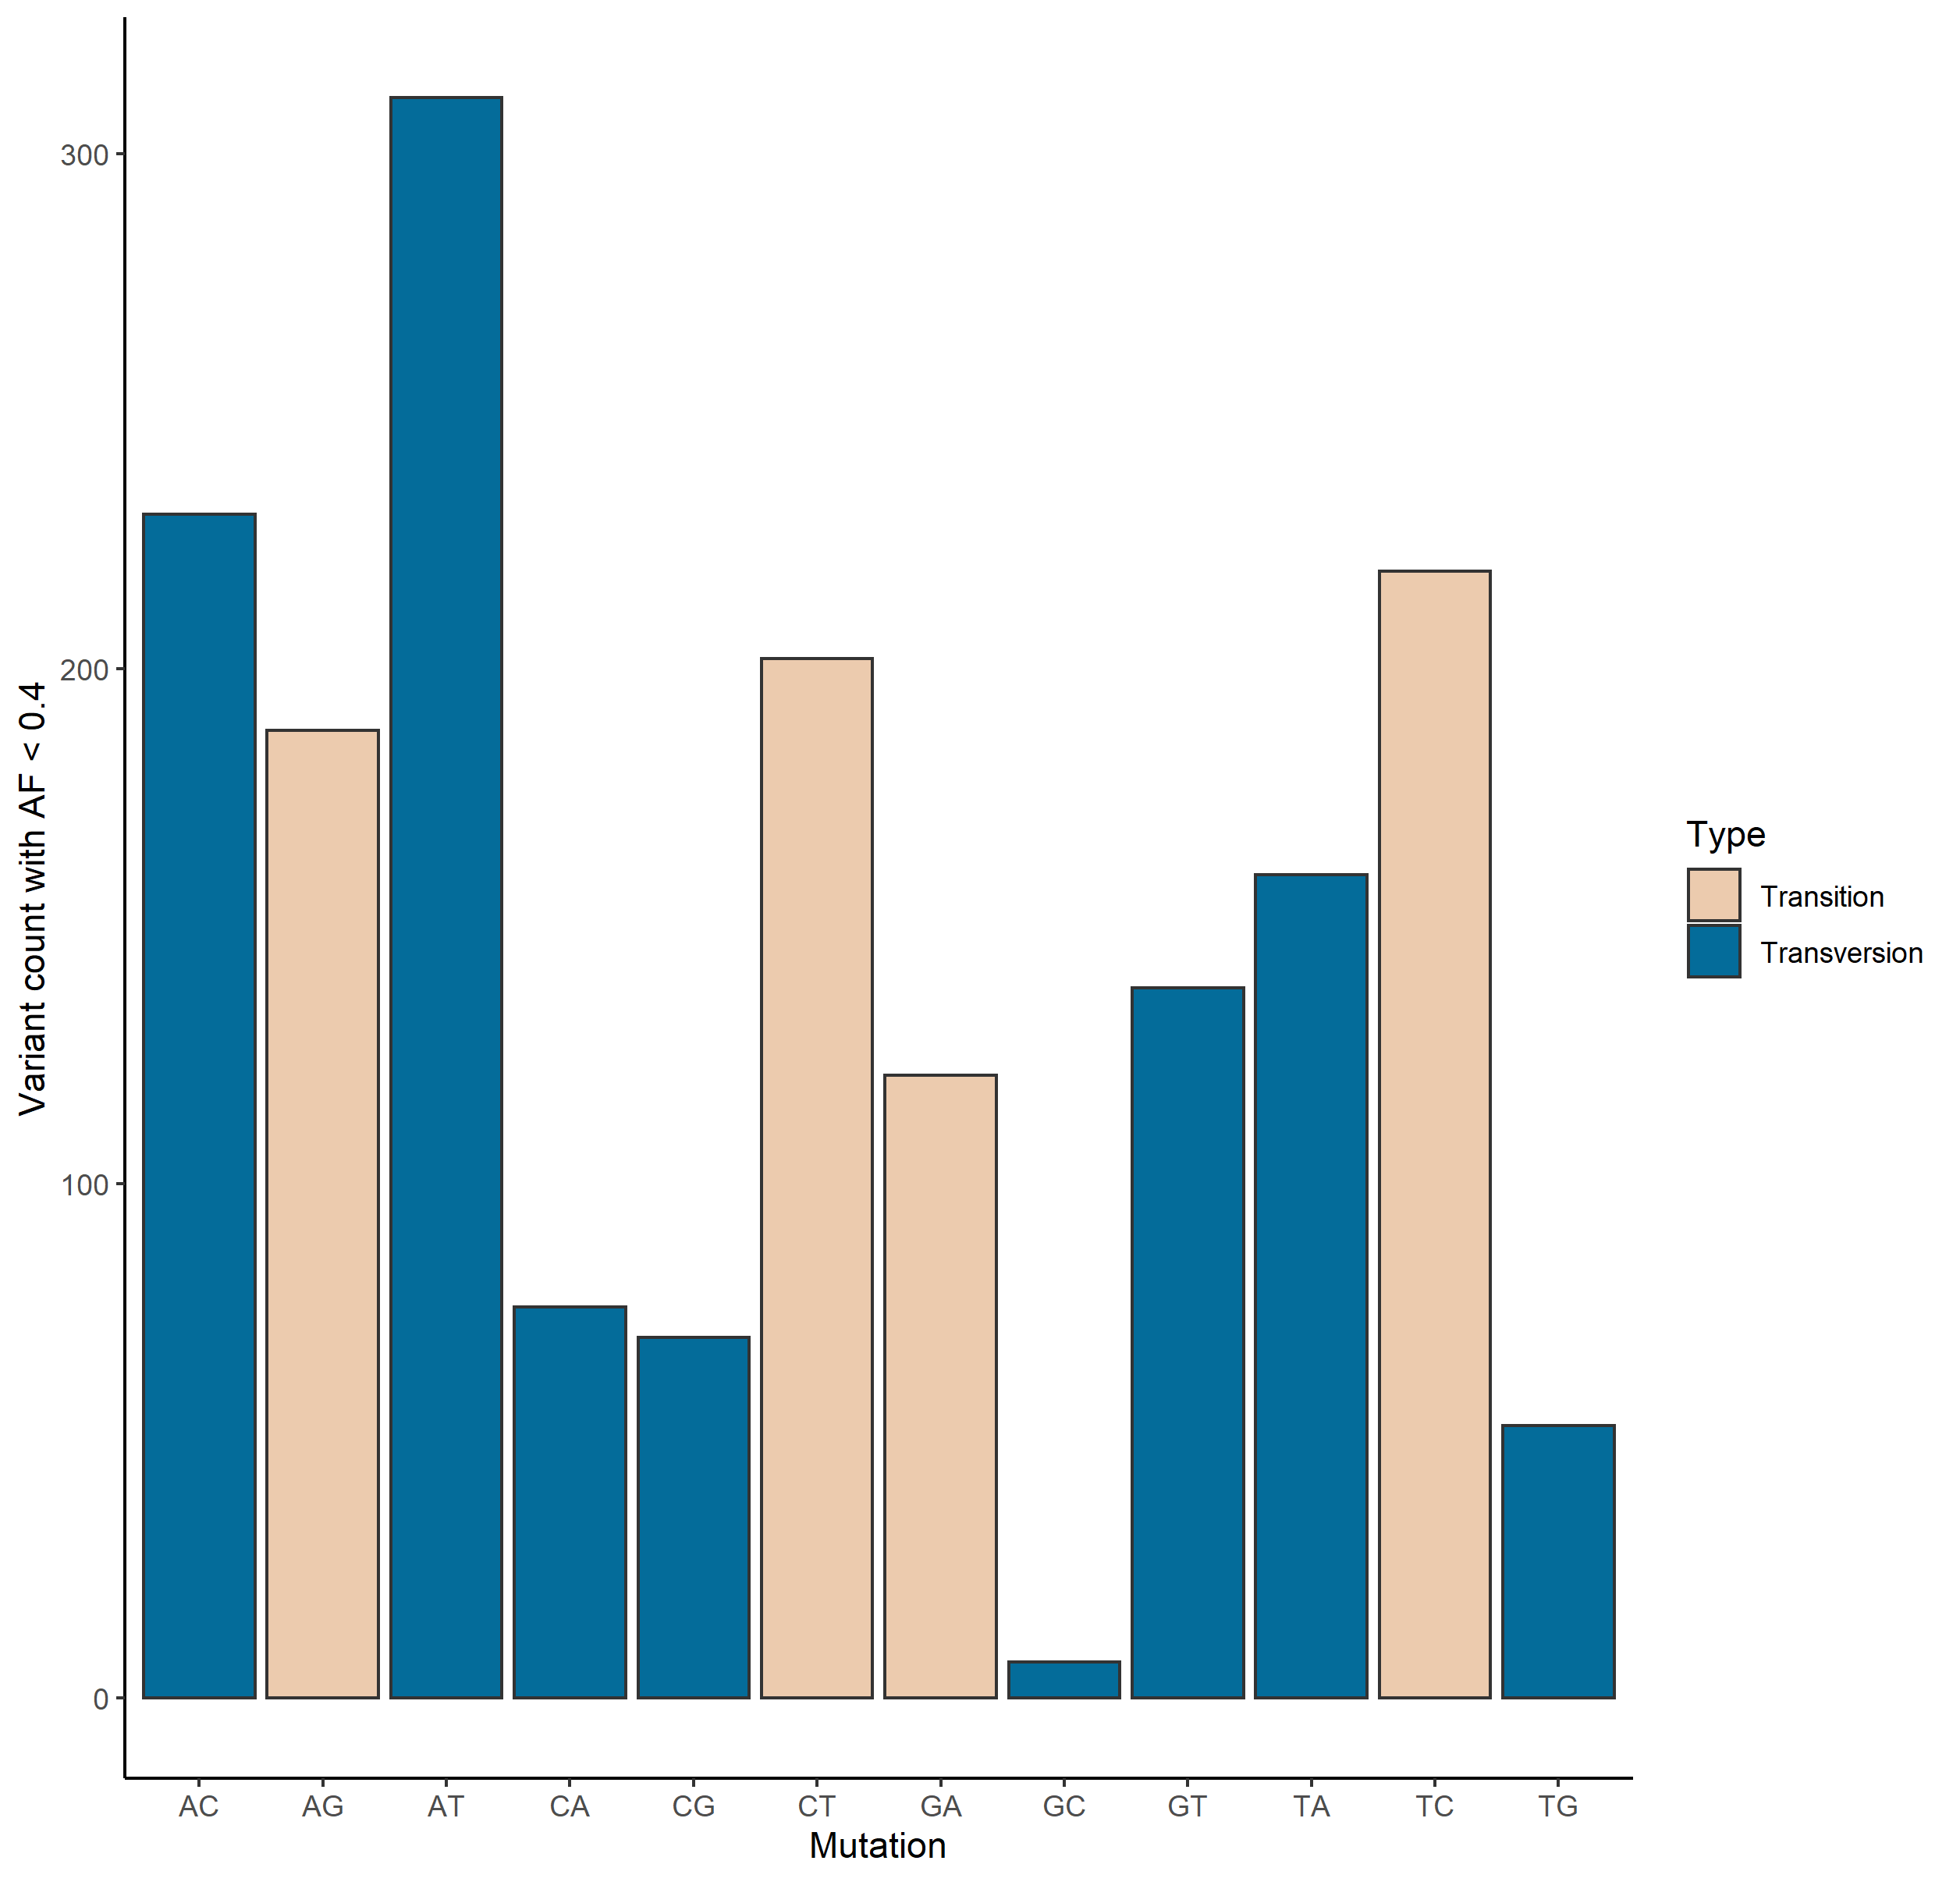
Mutational Signature of Low-AF Variants

Slide 41
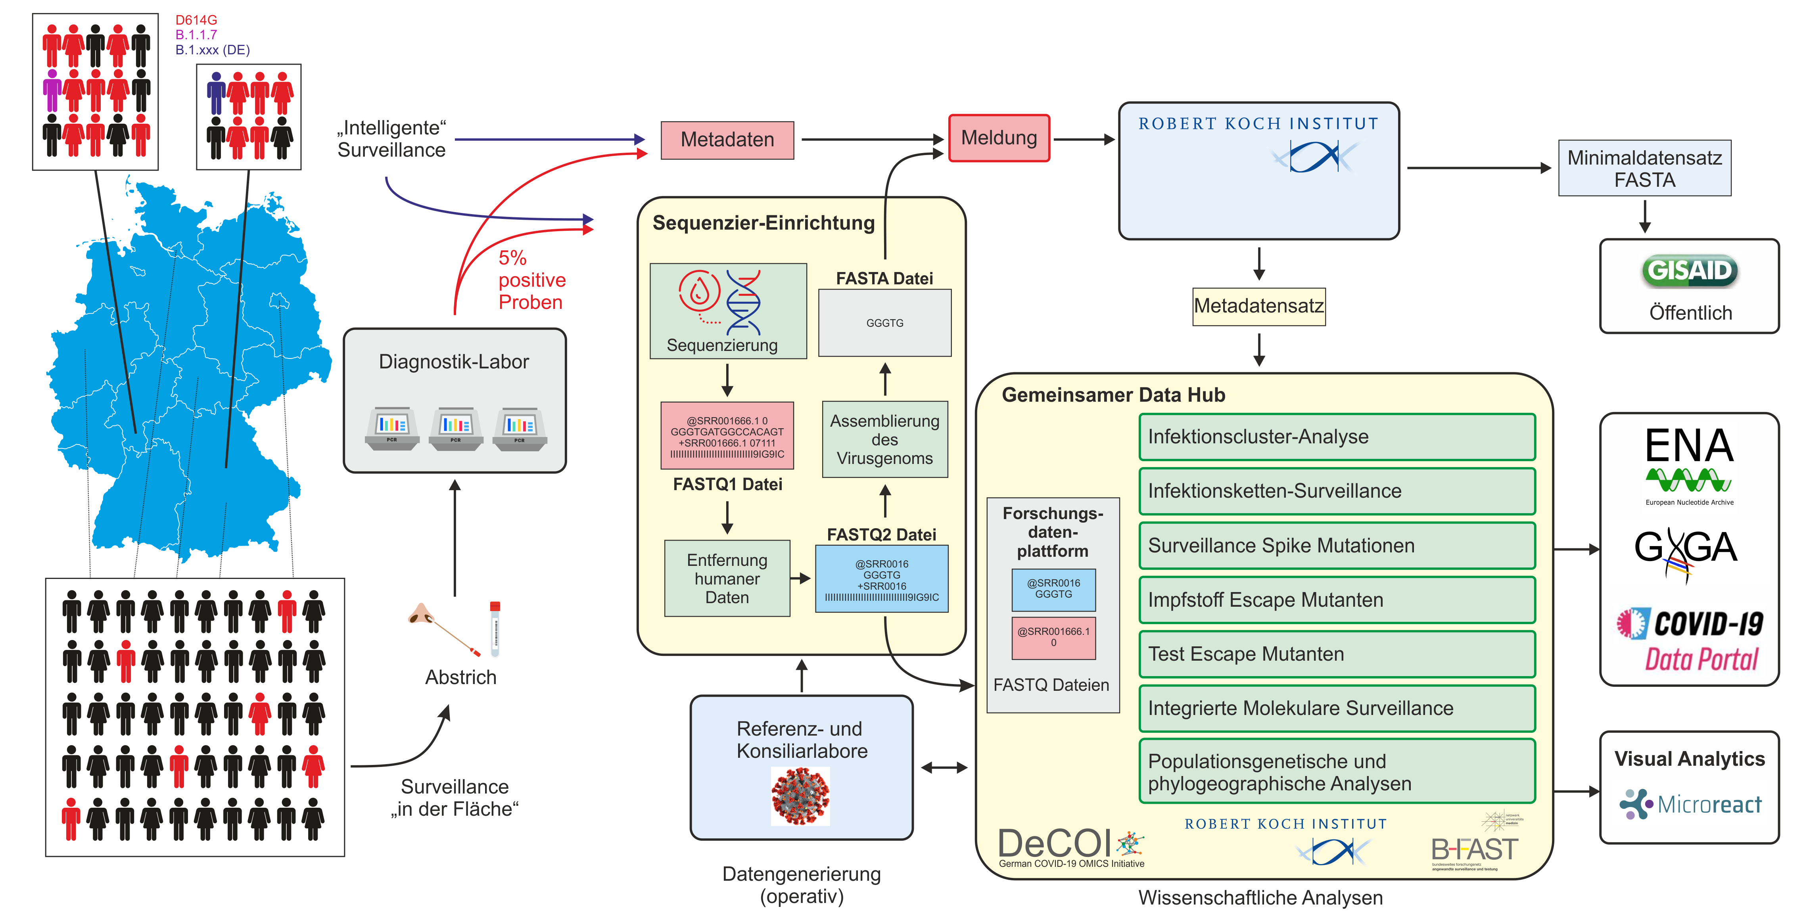


Outlook: Federated Molecular Surveillance in Germany
Joachim Schultze, Uni Bonn

Slide 42


Thanks!
Tübingen (NCCT, Microbiology, Human Genetics, QBiC): Michaela Pogoda
Angel Angelov
Michael Sonnabend
Marie Gauder
Silke Peter
Daniela Bezdan Nicolas Casadei
Olaf Riess
Tübingen Bioinfo:
Caspar Gross
Leon Schütz
Jakob Admard
Ersoy Kocak
CeBiTec Bielefeld: David Brandt Tobias Busche Markus Haak Jörn Kalinowski Levin-Joe Klages Alexander Sczyrba Marina Simunovic Svenja Vinke Ev. Klinikum Bethel, Bielefeld: Dr. Christiane Scherer MVZ Diamedis, Sennestadt: Dr. Thomas Diedrich MVZ Eberhard und Partner, Dortmund: Dr. Frank-Jörg Vorhölter Saarland University: Kathrin Kattler Jörn Walter
RKI: Oliver Drechsel Stephan Fuchs Max von Kleist Djin Ye Oh Aleksandar Radonic Maureen Smith Andrea Theumer Wiep van der Toorn Maria Trofimova Max Planck Institute SHH: Denise Kühnert Ariane Weber DRESDEN-concept Genome Center: Andreas Dahl Katrin Sameith-Lauber Sylke Winkler
HZI: Adrian Fritz Alice McHardy Cologne: Konrad Förstner
Tübingen Virology:
Tina Ganzenmüller
Angelika Iftner
Thomas Iftner
Twist:
Tina Han
Ulrike Harms
Oliver Stephan
Tübingen ICU:
Siri Göpel
Michael Bitzer
Düsseldorf: Alexander Dilthey
Maximilian Damagnez Ashley-Jane Duplessis Torsten Feldt Torsten Houwaart Lisanna Hülse Björn Jensen Malte Kohns Vasconcelos Susanne Kolbe-Busch Jessica Nicolai Klaus Pfeffer Daniel Strelow Jörg Timm Andreas Walker Tobias Wienemann
TU Munich (Virology, Computer Science): Elisabeth Esser Julien Gagneur Dieter Hoffmann Alexander Karollus Christian Mertes Thomas Michler Ulrike Protzer Eva-Christina Schulte Charité: Michael Hummel
DeCOI & NGS-CN:*

Slide 43
“Detecting known and novel mutations in a host's SARS-CoV-2 population by ultra-deep sequencing with unique molecular barcodes”
Questions?

